Slide 1
Pollard’s rho Algorithm
Lin Haibo
Department of Computer Science and Technology
Nanjing University

Slide 2
Pollard’s rho Algorithm
Naive Algorithm for Finding a Factor
Birthday Problem
Pollard’s rho Algorithm
Further Optimization
Application

Slide 3
Naive Algorithm for Finding a Factor

Slide 4
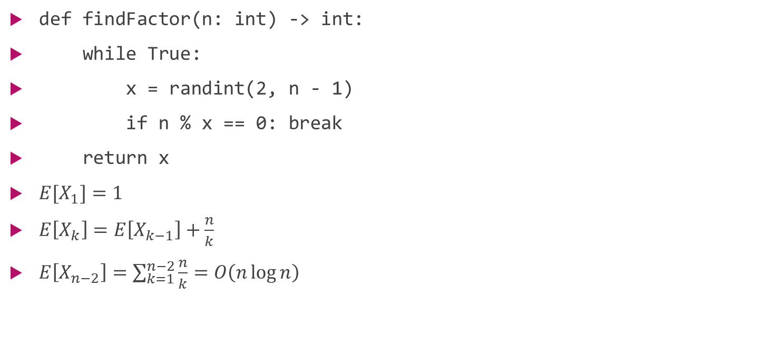
Naive Algorithm for Finding a Factor
def findFactor(n: int) -> int:
while True:
x = randint(2, n - 1)
if n % x == 0: break
return x
$E[X_{1}]=1$
$E\left[X_{k}\right]=E\left[X_{k−1}\right]+\frac{n}{k}$
$E\left[X_{n−2}\right]=\sum_{k=1}^{n−2}{\frac{n}{k}}=O\left(n\log{n}\right)$

Slide 5
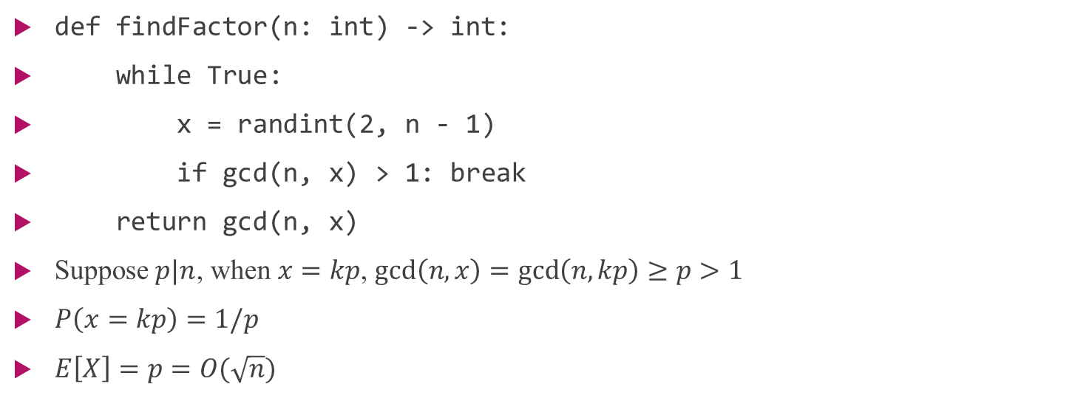
Naive Algorithm for Finding a Factor
def findFactor(n: int) -> int:
while True:
x = randint(2, n - 1)
if gcd(n, x) > 1: break
return gcd(n, x)
Suppose $p|n$, when $x=kp$, $gcd\left(n,x\right)=gcd\left(n,kp\right)≥p>1$
$P\left(x=kp\right)=1/p$
$E\left[X\right]=p=O(\sqrt{n})$
Notes:
Time O(sqrt(n)log(n))

Slide 6
Birthday Problem

Slide 7
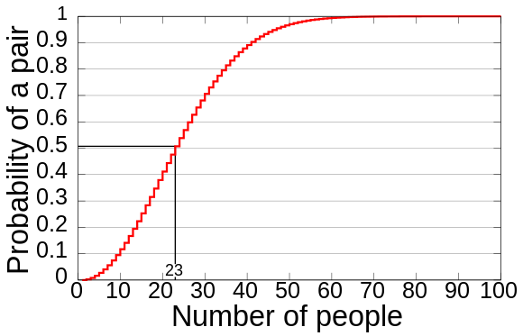
Birthday Problem
The computed probability of at least two people sharing a birthday versus the number of people*
Notes:
23 50%
70 99.9%
367 100% pigeonhole principle

Slide 8
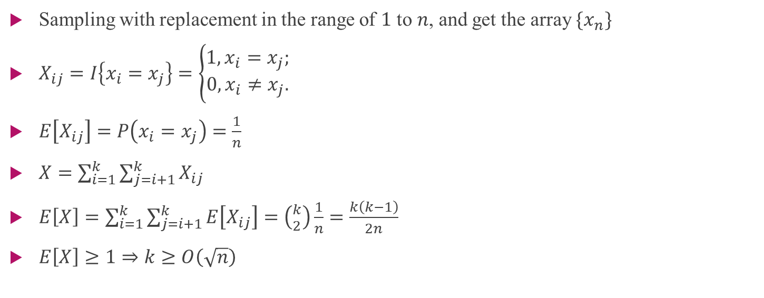
Birthday Problem
Sampling with replacement in the range of $1$ to $n$, and get the array $\{x_{n}\}$
$X_{ij}=I\left\{x_{i}=x_{j}\right\}=\left\{\begin{aligned}1,x_{i}=x_{j}; \\ 0,x_{i}≠x_{j}.\end{aligned}\right.$
$E\left[X_{ij}\right]=P\left(x_{i}=x_{j}\right)=\frac{1}{n}$
$X=\sum_{i=1}^{k}{\sum_{j=i+1}^{k}{X_{ij}}}$
$E\left[X\right]=\sum_{i=1}^{k}{\sum_{j=i+1}^{k}{E\left[X_{ij}\right]}}=\left({k \atop 2}\right)\frac{1}{n}=\frac{k\left(k−1\right)}{2n}$
$E\left[X\right]≥1⇒k≥O\left(\sqrt{n}\right)$
Notes:
k>sqrt(-ln(0.5)*2)sqrt(n)

Slide 9
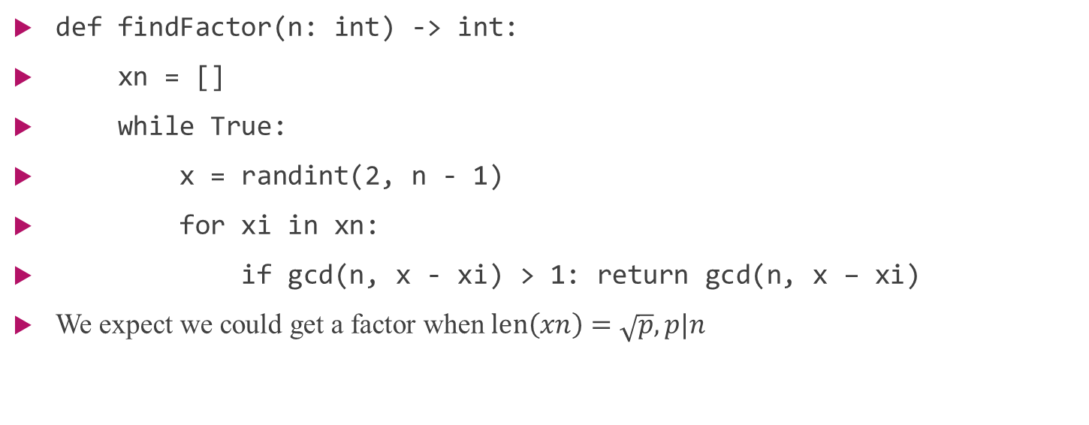
Birthday Problem
def findFactor(n: int) -> int:
xn = []
while True:
x = randint(2, n - 1)
for xi in xn:
if gcd(n, x - xi) > 1: return gcd(n, x – xi)
We expect we could get a factor when $len\left(xn\right)=\sqrt{p}, p|n$
Notes:
Expect len(xn)=sqrt(p) -> exists x – xi > 0 and x – xi mod p = 0 -> get factor
Time O(sqrt(n)log(n))

Slide 10
Pollard’s rho Algorithm
Notes:
pollard

Slide 11
Pollard’s rho Algorithm
Floyd’s cycle-finding algorithm
def floydFindCycle(f: generator) -> bool:
x = next(copy(f)), y = copy(f)
try:
while x != y:
x = next(next(x)), y = next(y)
return True
except StopIteration:
return False

Slide 12
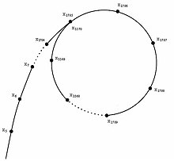
Pollard’s rho Algorithm
Cycle diagram resembling the Greek letter $ρ$*
Notes:
Stop when find a cycle

Slide 13
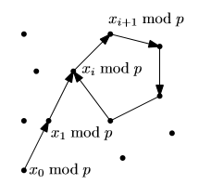
Pollard’s rho Algorithm
A cycle formed in the sequence $x_{0} mod p,x_{1} mod p,…$*

Slide 14
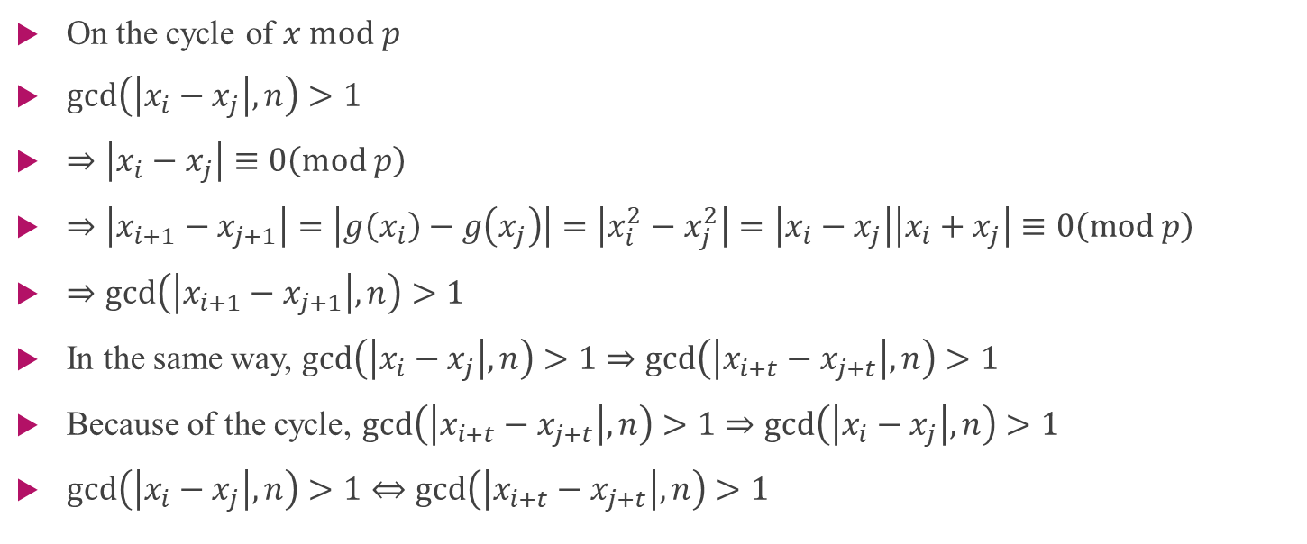
Pollard’s rho Algorithm
On the cycle of $x mod p$
$gcd\left(\left|x_{i}−x_{j}\right|,n\right)>1$
$⇒\left|x_{i}−x_{j}\right|≡0\left(mod p\right)$
$⇒\left|x_{i+1}−x_{j+1}\right|=\left|g\left(x_{i}\right)−g\left(x_{j}\right)\right|=\left|x_{i}^{2}−x_{j}^{2}\right|=\left|x_{i}−x_{j}\right|\left|x_{i}+x_{j}\right|≡0\left(mod p\right)$
$⇒gcd\left(\left|x_{i+1}−x_{j+1}\right|,n\right)>1$
In the same way, $gcd\left(\left|x_{i}−x_{j}\right|,n\right)>1⇒gcd\left(\left|x_{i+t}−x_{j+t}\right|,n\right)>1$
Because of the cycle, $gcd\left(\left|x_{i+t}−x_{j+t}\right|,n\right)>1⇒gcd\left(\left|x_{i}−x_{j}\right|,n\right)>1$
$gcd\left(\left|x_{i}−x_{j}\right|,n\right)>1⇔gcd\left(\left|x_{i+t}−x_{j+t}\right|,n\right)>1$

Slide 15
Pollard’s rho Algorithm
def pollardsRho(n: int) -> n:
g = lambda x: (x * x + 1) % n
x = y = 2
d = 1
while d == 1:
x = g(x), y = g(g(x))
d = gcd(abs(x – y), n)
return d
Notes:
Time O(n^(1/4)log(n))
Pseudo random number

Slide 16
Further Optimization

Slide 17
Further Optimization
def pollardsRho(n: int) -> n:
g = lambda x: (x * x + randint(0, n – 1)) % n
x = y = randint(0, n – 1)
d = 1
while d == 1:
x = g(x), y = g(g(x))
d = gcd(abs(x – y), n)
return d

Slide 18
Further Optimization
Brent’s cycle-finding algorithm
def BrentFindCycle(f: generator) -> bool:
x = copy(f), cycle = 0, find = True
try:
while find:
y = copy(x), cycle += 1
for _ in range(2 ** cycle):
x = next(x)
if x == y: find = False; break
return True
except StopIteration: return False

Slide 19
Further Optimization
def pollardsRho(n: int) -> n:
g = lambda x: (x * x + randint(0, n – 1)) % n
x = randint(0, n – 1)
for cycle in count(1):
y = x
for i in range(2 ** cycle):
x = g(x)
if gcd(abs(x – y), n) > 1:
return gcd(abs(x – y), n)

Slide 20
Further Optimization
It can be show that the number of function evaluations in Brent’s cycle-finding algorithm can never be higher than for Floyd’s algorithm
On average, Brent’s cycle-finding algorithm runs around 36% more quickly than Floyd’s
On average, it speeds up the Pollard’s rho algorithm by around 24%*

Slide 21
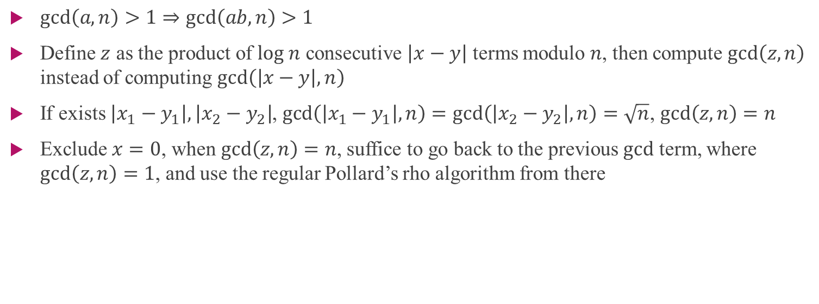
Further Optimization
$gcd\left(a,n\right)>1⇒gcd\left(ab,n\right)>1$
Define $z$ as the product of $log n$ consecutive $\left|x−y\right|$ terms modulo $n$, then compute $gcd\left(z,n\right)$ instead of computing $gcd\left(\left|x−y\right|,n\right)$
If exists $\left|x_{1}−y_{1}\right|,\left|x_{2}−y_{2}\right|$, $gcd\left(\left|x_{1}−y_{1}\right|,n\right)=gcd\left(\left|x_{2}−y_{2}\right|,n\right)=\sqrt{n}$, $gcd\left(z,n\right)=n$
Exclude $x=0$, when $gcd\left(z,n\right)=n$, suffice to go back to the previous $gcd$ term, where $gcd\left(z,n\right)=1$, and use the regular Pollard’s rho algorithm from there
Notes:
O(n^(1/4))

Slide 22
Application

Slide 23
Application
The Pollard’s rho algorithm's most remarkable success was the factorization of the Fermat number $F_{8}=1238926361552897⋅93461639715357977769163558199606896584051237541638188580280321$
The factorization took $2$ hours on a UNIVAC 1100/42*

Slide 24
Application
def findFactors(n: int) -> list:
if n == 1:
return []
else:
d = pollardsRho(n)
if d == n:
return [n]
return findFactors(d) + findFactors(n / d)
Notes:
T(n) = 2T(n/2) + n^(1/4)
O(n^(1/4)log(n))

Slide 25
Application
The general number field sieve (GNFS) is the most efficient classical algorithm known for factoring integers larger than ${10}^{100}$
Heuristically, its complexity for factoring an b-bit integer $n$ is of the form
$exp \left(\left(\sqrt[3]{\frac{64}{9}}+o\left(1\right)\right){\left(ln n\right)}^{\frac{1}{3}}{\left(ln ln n\right)}^{\frac{2}{3}}\right)=exp\left(\left(\sqrt[3]{\frac{64}{9}}+o\left(1\right)\right)b^{\frac{1}{3}}{\left(ln b\right)}^{\frac{2}{3}}\right)$*
Notes:
No b^k
Faster than e^b

Slide 26
Application
On a quantum computer, to factor an integer $n$, Shor’s algorithm runs in polynomial time
Specifically, it takes quantum gates of order $O\left({\left(log n\right)}^{2}\left(log log n\right)\left(log log log n\right)\right)$ using fast multiplication, thus demonstrating that the integer-factorization problem can be efficiently solved on a quantum computer*

Slide 27
Thank you!

