Slide 1
作业1-5

Slide 2
Algorithm getAllPermutation(N)
Input:
N: a positive integer
Output:
All the permutation aof A_{N}
Subprocess permutation(int N, int k, int*used)
If(k==N){
for(int i=0;i<N;i++){
cout<<perm[i]<<“ “;
}
cout<<endl;
}
for(int i=1;i<=N;i++){
if(used[i]==0){
perm[k]=i;
used[i]=1;
permutation(N,k+1,used);
used[i]=0;
}
}
int [N+1]used={0,0,…0};
int [N]perm;
permutation(N,0,used)

Slide 3
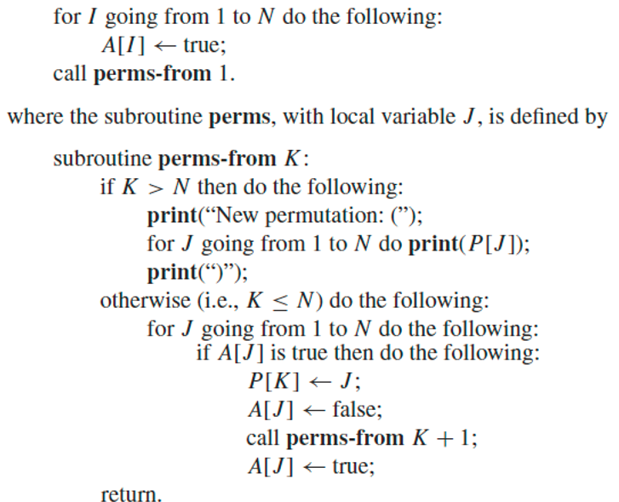

Slide 4
read(x), push(x,s),
read(x), push(x,s),
read(x), print(x),
pop(x), print(x)
pop(x), print(x)
read(x), push(x,s),
read(x), push(x,s),
read(x), print(x),//3
read(x), push(x,s),
read(x), print(x),//5
read(x), push(x,s),
read(x), print(x),//7
pop(x), print(x),//6
read(x), print(x),//8
pop(x), print(x),//4
read(x), print(x),//9
pop(x), print(x),//2
read(x), print(x),//10
pop(x), print(x),//1
read(x), push(x,s),
read(x), push(x,s),
read(x), print(x),
read(x), print(x),
pop(x), print(x)
pop(x), print(x)

Slide 5
(3,1,2)
3输出时，2和1必然在栈中，2必须在1之上，所以2必然比1先出栈；
(4,5,3,7,2,1,6)
7输出时，6、2和1必然在栈中，6必须在2、1之上，所以6必然比2、1先出栈；
如果Permutation包含一个子序列x,y,z，满足x>z>y，则无法用一个stack来生成
Notes:
不能满足条件，x,y,z x>z>y

Slide 6
(c) How many permutations of A4 cannot be obtained by a stack?
10：枚举
(1,4,2,3)
(2,4,1,3)
(3,1,2,4) (3,1,4,2) (3,4,1,2)
(4,1,2,3) (4,1,3,2) (4,2,1,3) (4,2,3,1) (4,3,1,2)
(c) How many permutations of A_{N} can be obtained by a stack?

Slide 7
(c) How many permutations of A_{N} can be obtained by a stack?
C(N)=# permutations of A_{N} can be obtained by a stack
$C\left(N\right)=\frac{\left(2∗N\right)!}{N!∗\left(N+1\right)!}$
(Catalan Numbers)
$$C\left(n\right)=C\left(0\right)∗C\left(n−1\right)+C\left(1\right)∗C\left(n−2\right)+C\left(2\right)∗C\left(n−3\right)+…+C\left(n−1\right)∗C\left(0\right) \\ =\sum_{i=0\sim n−1}{C\left(i\right)∗C(n−1−i)}$$
C(0)=1
https://en.wikipedia.org/wiki/Catalan_number

Slide 8
(c) How many permutations of A_{N} can be obtained by a stack?
一个长度为2n的合法的push，pop序列，唯一的确定了一个permutation
假设n=4
push, pop, push, pop, push, pop, push, pop
1234
push, push, pop, pop, push, pop, push, pop
2134
push, push, push, push, pop, pop, pop, pop
4321
合法：
pop总数=push总数
任意前缀中的pop数量<=push数量

Slide 9
(c) How many permutations of A_{N} can be obtained by a stack?
push：视为向右移动一个单位
pop：视为向上移动一个单位
(n,n)
则任意一个长度为2n，包含n个push和n个pop的序列，可以唯一的确定一条从（0,0）到（n,n）的路径（path）
这样的路径共有A条，$A=\left(\begin{aligned}2n \\ n\end{aligned}\right)$
(0,0)

Slide 10
(c) How many permutations of A_{N} can be obtained by a stack?
push：视为向右移动一个单位
pop：视为向上移动一个单位
(n,n)
则任意一个长度为2n，包含n个push和n个pop的序列，可以唯一的确定一条从（0,0）到（n,n）的路径（path）
合法pop/push序列：
pop总数=push总数
任意前缀中的pop数量<=push数量
(0,0)
不向上跨越对角线的path
假设这样的路径共有B条，$B$=？
令从（0,0）到达（n,n）的跨越了对角线的路径共有C条，则B=A-C

Slide 11
(c) How many permutations of A_{N} can be obtained by a stack?
push：视为向右移动一个单位
pop：视为向上移动一个单位
(n,n)
令从（0,0）到达（n,n）的跨越了对角线的路径共有C条
(0,0)

Slide 12
(c) How many permutations of A_{N} can be obtained by a stack?
(n-1,n+1)
push：视为向右移动一个单位
pop：视为向上移动一个单位
(n,n)
令从（0,0）到达（n,n）的跨越了对角线的路径共有C条
从（0,1）向（n,n+1）坐一个对角线，将原先路径中第一次接触该对角线的部分以该对角线为轴，做个对称。
(0,0)

Slide 13
(c) How many permutations of A_{N} can be obtained by a stack?
(n-1,n+1)
push：视为向右移动一个单位
pop：视为向上移动一个单位
(n,n)
令从（0,0）到达（n,n）的跨越了对角线的路径共有C条
从（0,1）向（n,n+1）坐一个对角线，将原先路径中第一次接触该对角线的部分以该对角线为轴，做个对称。
用对称部分替换原先部分，得到一个新的路径，该路径必然以（n-1, n+1）为终点
(0,0)
这样的路径必然包含n-1次向右移动，n+1次向上移动
$$C=\left(\begin{aligned}2n \\ n−1\end{aligned}\right)=\left(\begin{aligned}2n \\ n+1\end{aligned}\right)$$
$$B=A−C=\left(\begin{aligned}2n \\ n\end{aligned}\right)−\left(\begin{aligned}2n \\ n+1\end{aligned}\right)$$

Slide 14
Algorithm genOperations(P)
Input
P: a permutation of A_{N}
Output
“NO”, if P can not be obtained by a stack
“YES” and S_{O} : a sequence of operations generate P, if P can be obtained by a stack
$E←$true;
I $←$ 1;
ops $←$ EmptyList;
while input is not empty and E=true do the following:
read(Y);
while Y>I do the following:
push(I,S);
ops.add(1);
I $←$ I+1;
if Y=I then do the following:
ops.add(2); I $←$ I+1;
else do the following:
pop(Z,S);
ops.add(3);
if(Z!=Y) do the following:
E $←$false;
break;
if E=true do the following:
print(“YES”);
for each integer o in ops do:
if o=1 do:
print(“read(X); push(X,S);”);
else if o=2 do：
print(“read(X); print(X);”);
else if o=3 do:
print(“pop(X,S);”);
else do:
print (“NO”);

Slide 15
(a)(3,1,2)
read(x); push(x,s); read(x); push(x,s); read(x); print(x); pop(x,s); push(x,s’); pop(x,s); print(x); pop(x,s’); print(x);
(b)
(C)
S
S’
1
2
3
4
5
4
3
2
6
1
5
3
4
5
1
2
S
S’
3
4
2
6
1
5

Slide 17
T$←$ new node(A[1]);
for i $←2$ to N do:
Tc $←$T;
while true do:
if T.v>A[i] do:
if T.left=null do:
T.left $←$new node(A[i]);
break;
else do:
T $←$T.left;
else if T.v<A[i] do:
if T.right=null do:
T.right $←$new node(A[i]);
break;
else do:
T $←$T.right;
retrun T;
Input:
A[1,…,N]: an array of distinct integers
Output:
T: the root node of an binary search tree exactly containing all integers from A;

