Slide 1
Applications of Red-Black Trees
Liu Min
2020.9.9

Slide 2
AVL Trees & RB Trees
01
OVERVIEW
Comparison and Application
Red-Black Trees in STL
02
Set, Map, Multiset and Multimap

Slide 3
PART ONE
AVL Trees & RB Trees
· Introduction to AVL Trees
· AVL Trees & Red-Black Trees

Slide 4
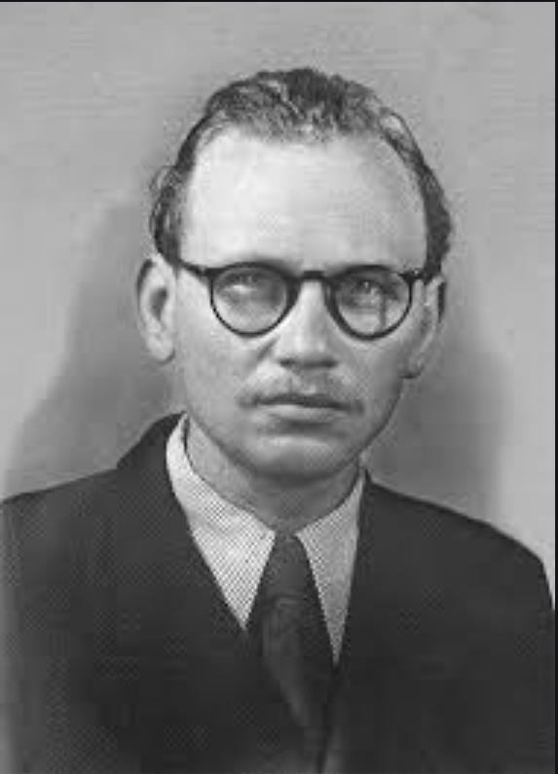
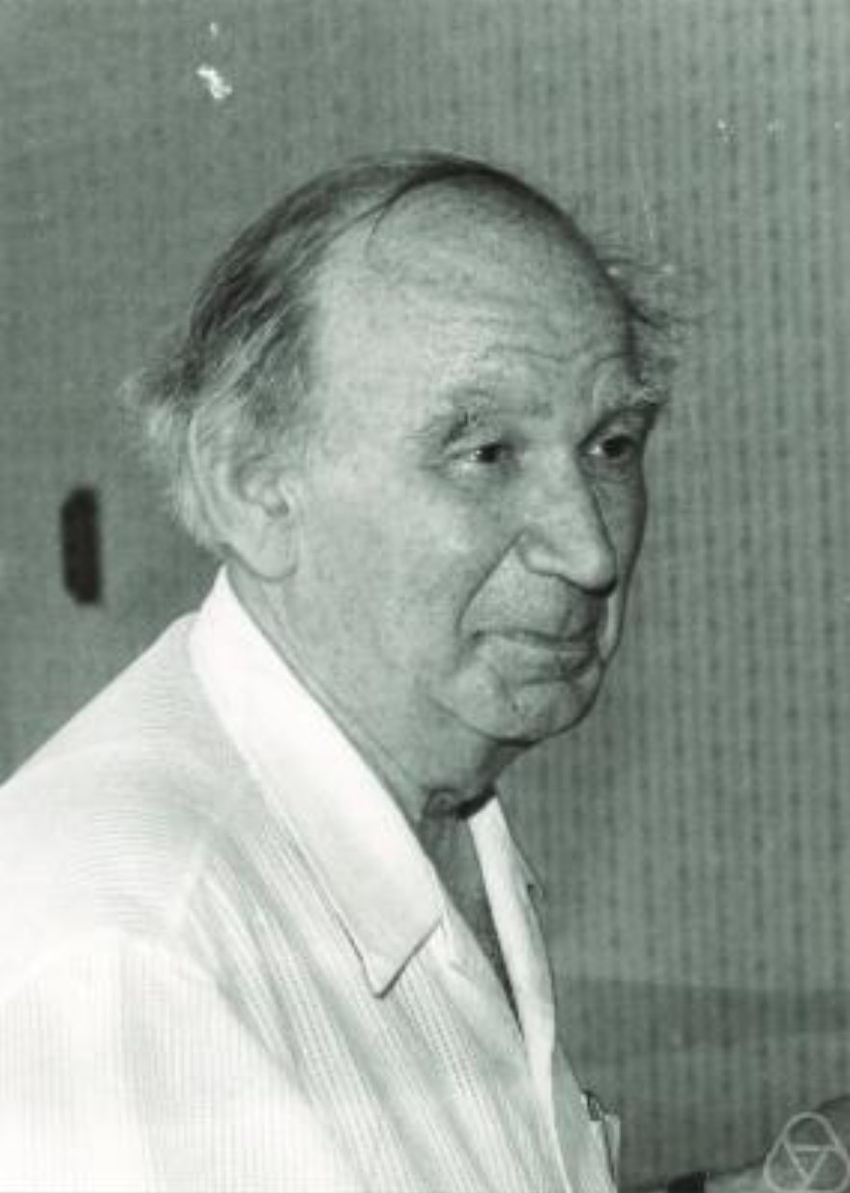
Introduction to AVL Trees
· named after inventors Adelson-Velsky and Landis
添加标题
Georgy Adelson-Velsky
USSR, 1922-2014
Evgenii Mikhailovich Landis
USSR, 1921-1997

Slide 5
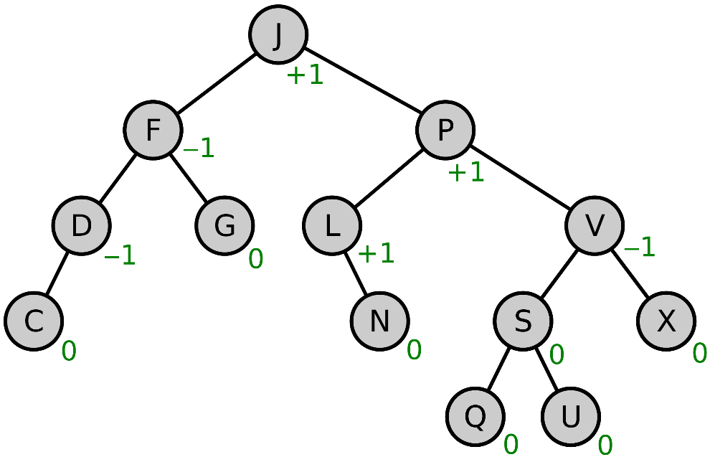
AVL Tree: Definition
Balance factor:
$$BlanceFactor\left(node\right)≔Height\left(RightSubtree\left(node\right)\right)−Height(LeftSubtree(node))$$
A binary tree is defined to be an AVL tree if the variant
$$BlanceFactor\left(node\right)∈\{−1,0,1\}$$
holds for every node in the tree.

Slide 6
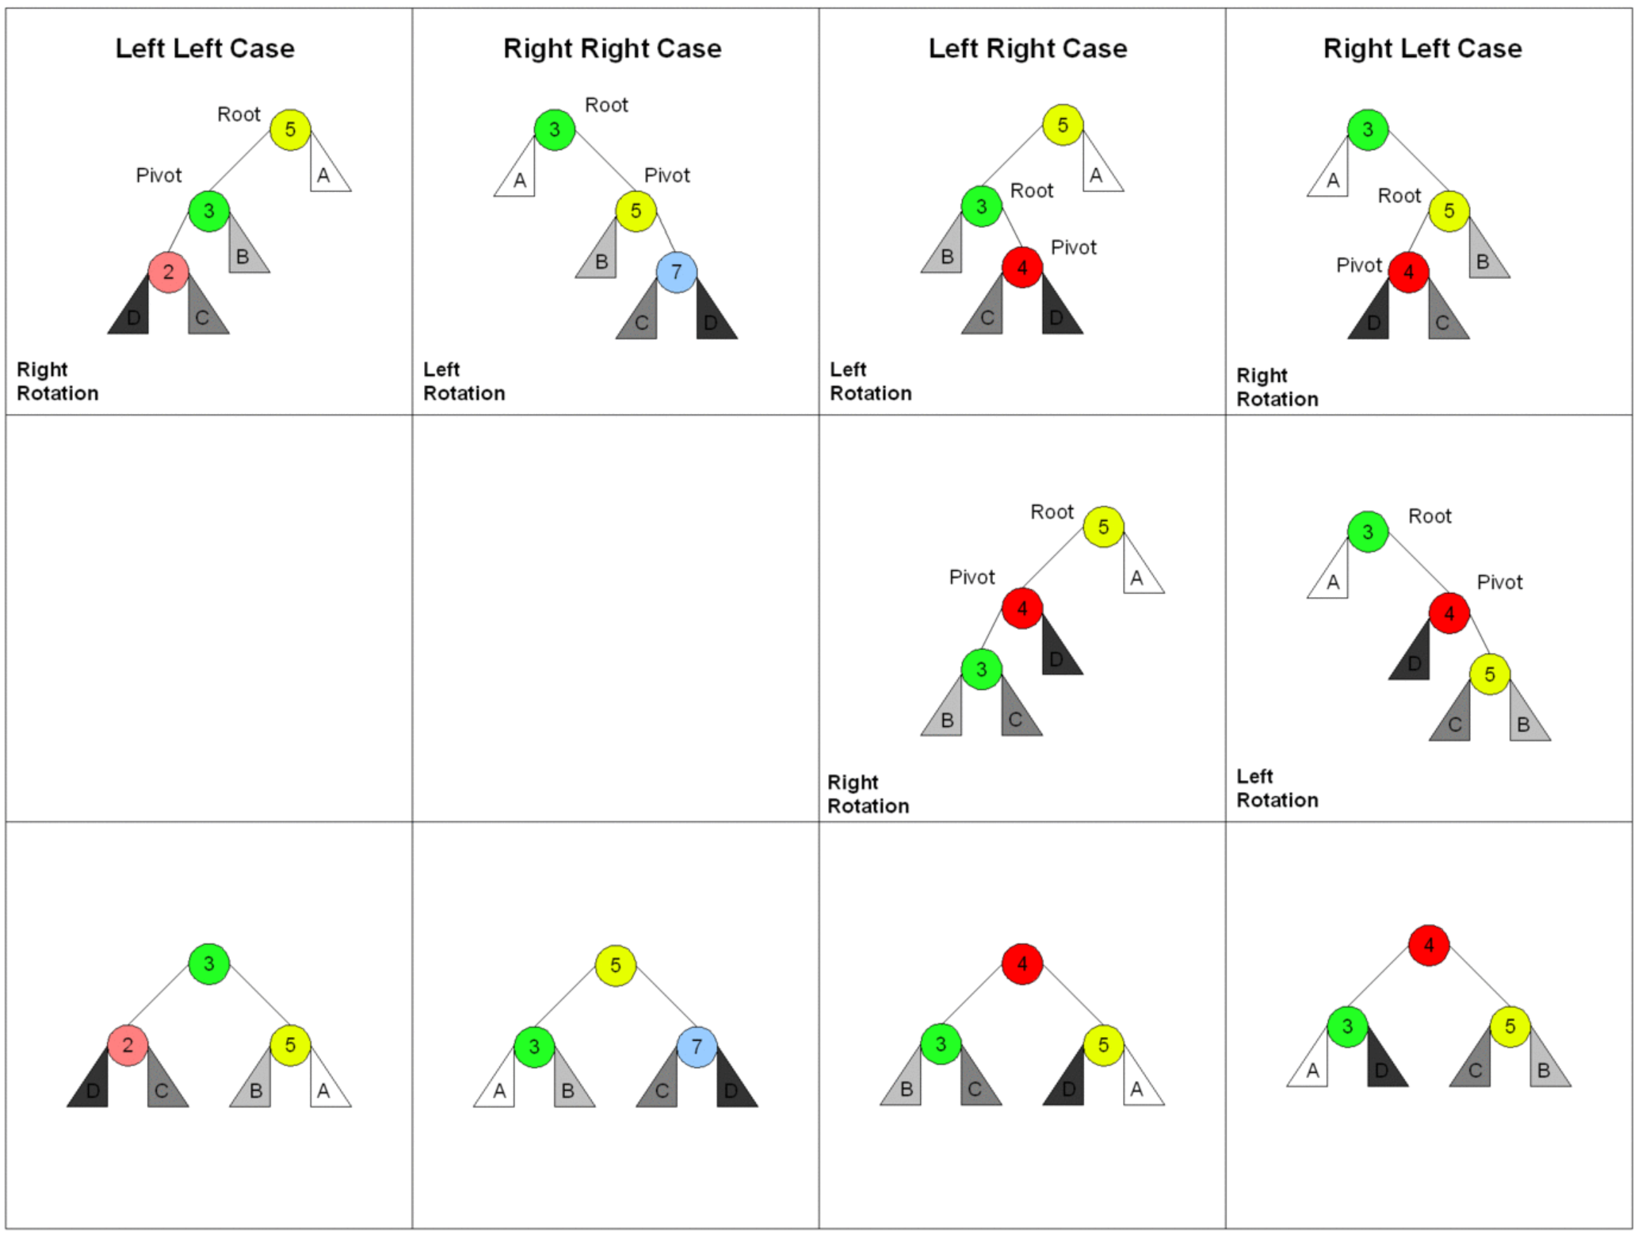
AVL Tree: Insertion & Deletion
Tree Rebalancing
(rotation)
Insert / Delete a node
→ Fix up
AVL tree animation

Slide 7
Red-Black Tree vs AVL Tree
· Self-Balancing Binary Search Tree
· insert / delete → Fix up (retracing and rotation)
· Time Complexity:
Search: O(logn)
Insertion: O(logn) //Each Rotation: O(1)
Deletion: O(logn)
· Extra information: color or balance factor
添加标题
请在此添加文字说明，编辑文字。请在此添加文字说明，编辑文字。请在此添加文字说明，编辑文字。请在此添加文字说明，编辑文字。请在此添加文字说明，编辑文字。请在此添加文字说明，编辑文字。
Why do we need Red-Black Trees?

Slide 8
Red-Black Tree vs AVL Tree
AVL Trees:
· more balanced → suitable for lookup-intensive applications
Red-Black Trees:
· no more than 3 rotations (insertion: $≤2$ deletion: $≤3$)
· rarely trace back to the root
· if keys $≥0$, we can store the color information in the sign bit
→ suitable for insert(delete)-intensive tasks
添加标题
请在此添加文字说明，编辑文字。请在此添加文字说明，编辑文字。请在此添加文字说明，编辑文字。请在此添加文字说明，编辑文字。请在此添加文字说明，编辑文字。请在此添加文字说明，编辑文字。
Red-Black Trees are more popular in application.
Notes:
AVL trees perform better than red-black trees for lookup-intensive applications

Slide 9
PART TWO
Red-Black Trees in STL
· rb_tree Container
· Associative Containers Based on rb_tree
· Introduction to Map

Slide 10
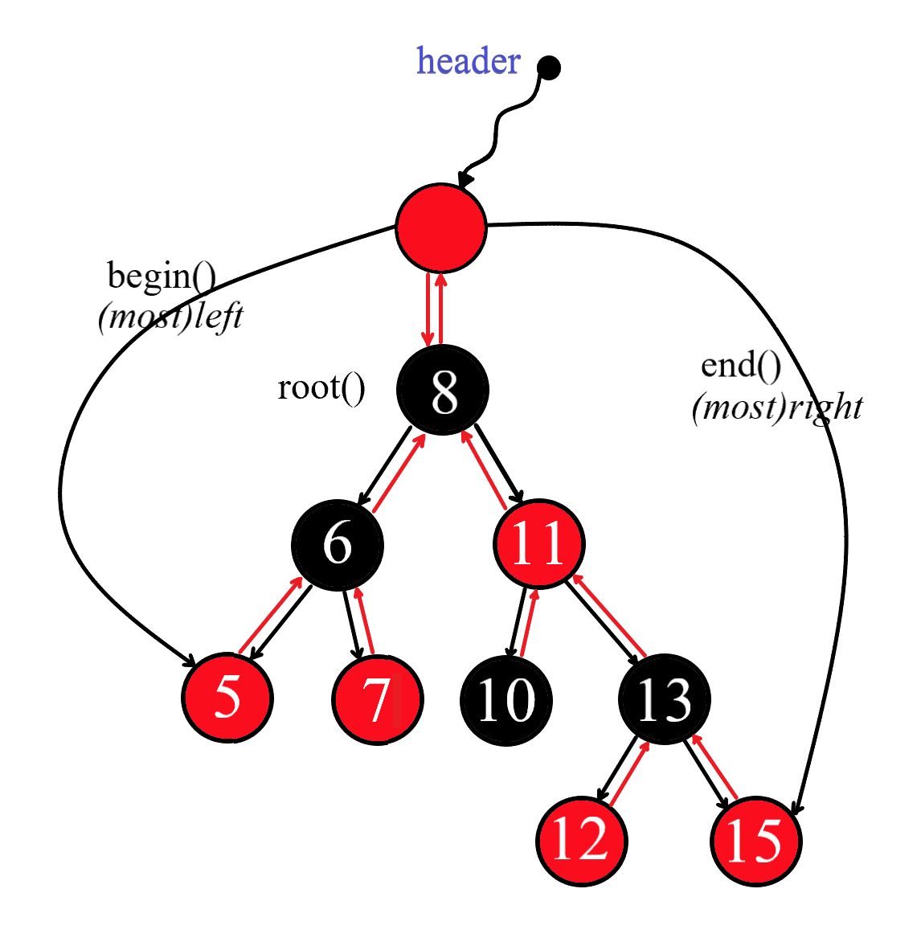
rb_tree Container
· header
· iterator:
(1)++iterator, traverse the tree → sorted
(2)we should not change the value of a
node using the iterator, but this is not
prohibited in the programming level
(we need to change the data in a map)
· insert_unique()
insert_equal()
set, multiset, map, multimap
Notes:
AVL trees perform better than red-black trees for lookup-intensive applications

Slide 11
Associative Containers: set & multiset
· value = key
· iterator
(1)based on rb_tree → sorted
(2)we cannot use the iterators to change
the keys: iterators of a set/multiset are
based on const iterators of an rb_tree
· set: insert_unique()
multiset: insert_equal()
Notes:
AVL trees perform better than red-black trees for lookup-intensive applications

Slide 12
Associative Containers: map & multimap
· value = key, data
· iterator
(1)based on rb_tree → sorted(key)
(2)we cannot use the iterators to change
the keys: the key type offered by the
user is set to be const automatically
· map: insert_unique()
multimap: insert_equal()
Notes:
AVL trees perform better than red-black trees for lookup-intensive applications

Slide 13
Introduction to Map
template < class Key, //map::key_type
class T, // map::mapped_type
class Compare = less<Key>, // map::key_compare
class Alloc = allocator<pair<const Key,T> > // map::allocator_type
> class map;
typedef pair<const Key, T> value_type;
Notes:
AVL trees perform better than red-black trees for lookup-intensive applications

Slide 14
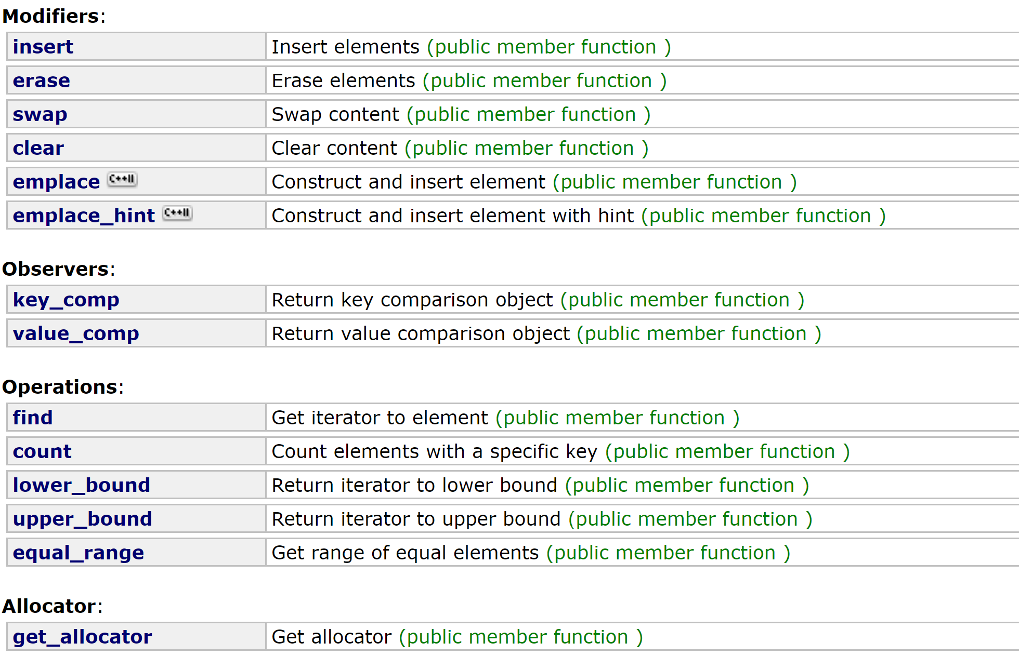
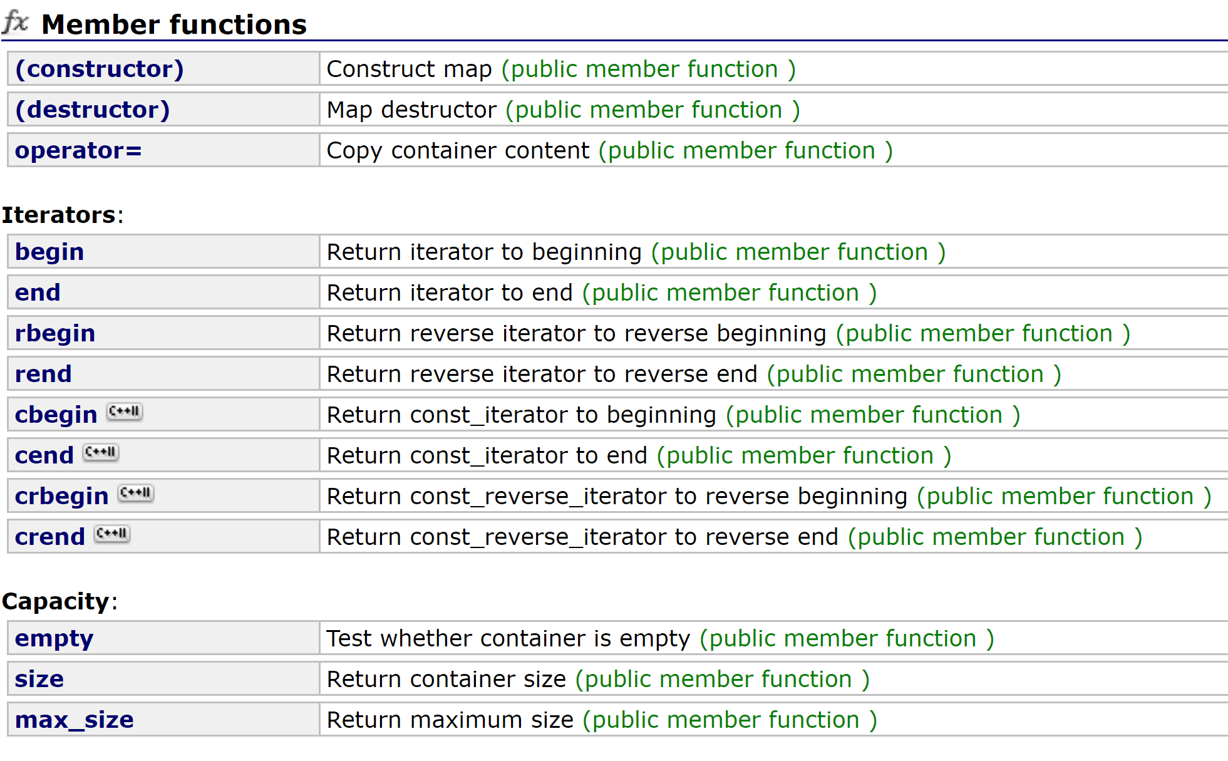
Introduction to Map: Member Functions
cplusplus.com
Member Functions:
Use the member functions offered by the containers.
Notes:
AVL trees perform better than red-black trees for lookup-intensive applications

Slide 15
Introduction to Map: Operator [ ]
map<int, string> mp;
mp.insert(pair<int, string>(1, “one”));
mp.insert(make_pair<int, string>(2, ”two”));
mp.insert(map<int, string>::value_type(3, “three”));
mp[4] = “four”;
typedef pair<const Key, T> value_type;
Notes:
AVL trees perform better than red-black trees for lookup-intensive applications

Slide 16
Introduction to Map: Operator [ ]
#if __cplusplus >= 201103L
mapped_type&
operator[](key_type&& __k)
{
// concept requirements
__glibcxx_function_requires(_DefaultConstructibleConcept<mapped_type>)
iterator __i = lower_bound(__k);
// __i->first is greater than or equivalent to __k.
if (__i == end() || key_comp()(__k, (*__i).first))
__i = _M_t._M_emplace_hint_unique(__i,
std::piecewise_construct, std::forward_as_tuple(std::move(__k)),
std::tuple<>());
return (*__i).second;
}
#endif
lower_bound: a version a binary search
return an iterator pointing to the first element that is not less than __k
__i = insert(__i, value_type(__k, mapped_type));
Test:
Notes:
AVL trees perform better than red-black trees for lookup-intensive applications

Slide 17
References:
· AVL Tree - Wikipedia:
https://en.wikipedia.org/wiki/AVL_tree
· Red-Black Tree vs AVL Tree – GeeksforGeeks:
https://www.geeksforgeeks.org/red-black-tree-vs-avl-tree/
· 侯捷 C++ STL与泛型编程:
https://www.bilibili.com/video/BV1Hb411K763?p=23
· std::map - cplusplus.com:
http://www.cplusplus.com/reference/map/map/?kw=map
Notes:
AVL trees perform better than red-black trees for lookup-intensive applications

Slide 18
Thanks for Listening!

