Slide 1
Dilworth theorem and Duality in graph
Zhao-H. Yin

Slide 2

Review : Set Order
A set $S$ is partially ordered over $≼$if

Slide 3
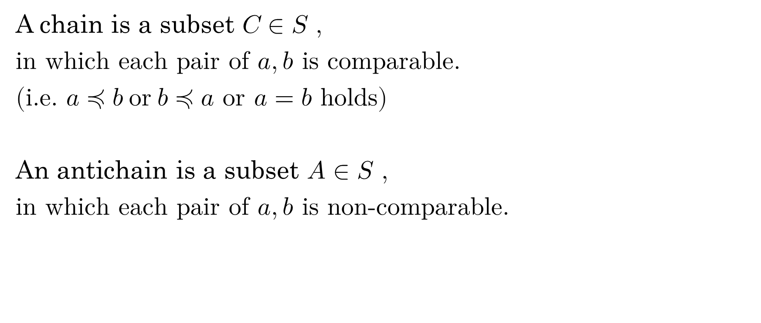
Chain
A chain is a subset $C∈S$ ,
in which each pair of $a,b$ is comparable.
(i.e. $a≼b or b≼a$ or $a=b$ holds)
An antichain is a subset $A∈S$ ,
in which each pair of $a,b$ is non-comparable.

Slide 4

Division
Any nonempty set $S$ can be divided into chains $C_{1},C_{2},…C_{s}$
Any nonempty set $S$ always contains antichain.

Slide 5
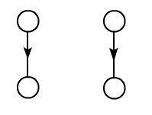
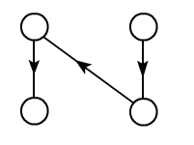
Observation
Size of the largest antichain in the following sets ?
The smallest number of chains dividing the set?
$$A_{max}=2$$
$$A_{max}=1$$
$$D_{min}=2$$
$$D_{min}=1$$

Slide 6
Theorem
(Dilworth,1950)
For any finite partially ordered set $S$
$$A_{max}=D_{min}$$

Slide 7
Observation
Having learnt basic proving skills graph theory,
one can try to figure out the proof by himself.
Do some observation first.
1. What does $A_{max}$ imply ?
We can not add any new point $u$ into the antichain $A$.
$∀ u∈S −A,∃ v∈A$, there exists a path connecting $u,v$
(Local Maximal)

Slide 8
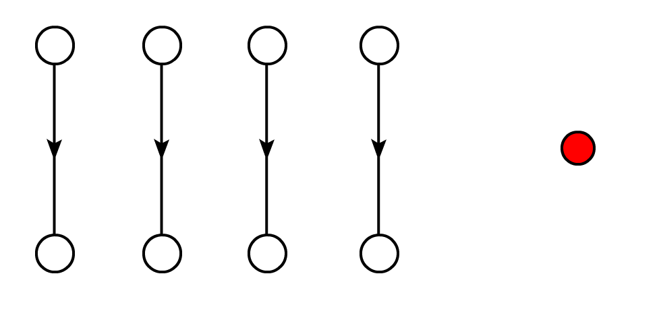
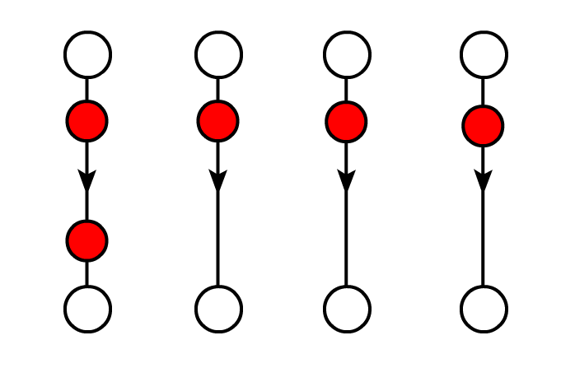
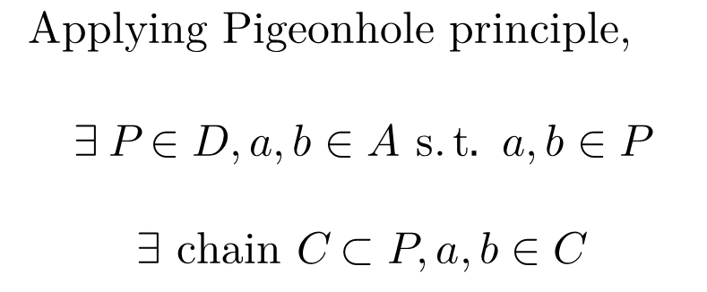
Observation
2. Easy to verify $\left|D\right|≥|A|$
By Contradiction. If $∃A,D,|D|<|A|$
Applying Pigeonhole principle,
$$∃ P∈D,a,b∈A s.t. a,b∈P$$
$$∃ chain C⊂P, a,b∈C$$

Slide 9
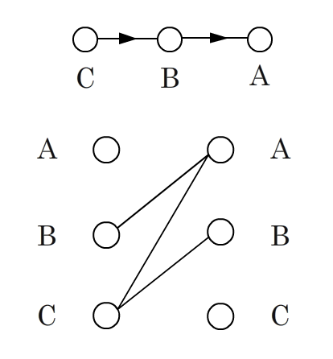
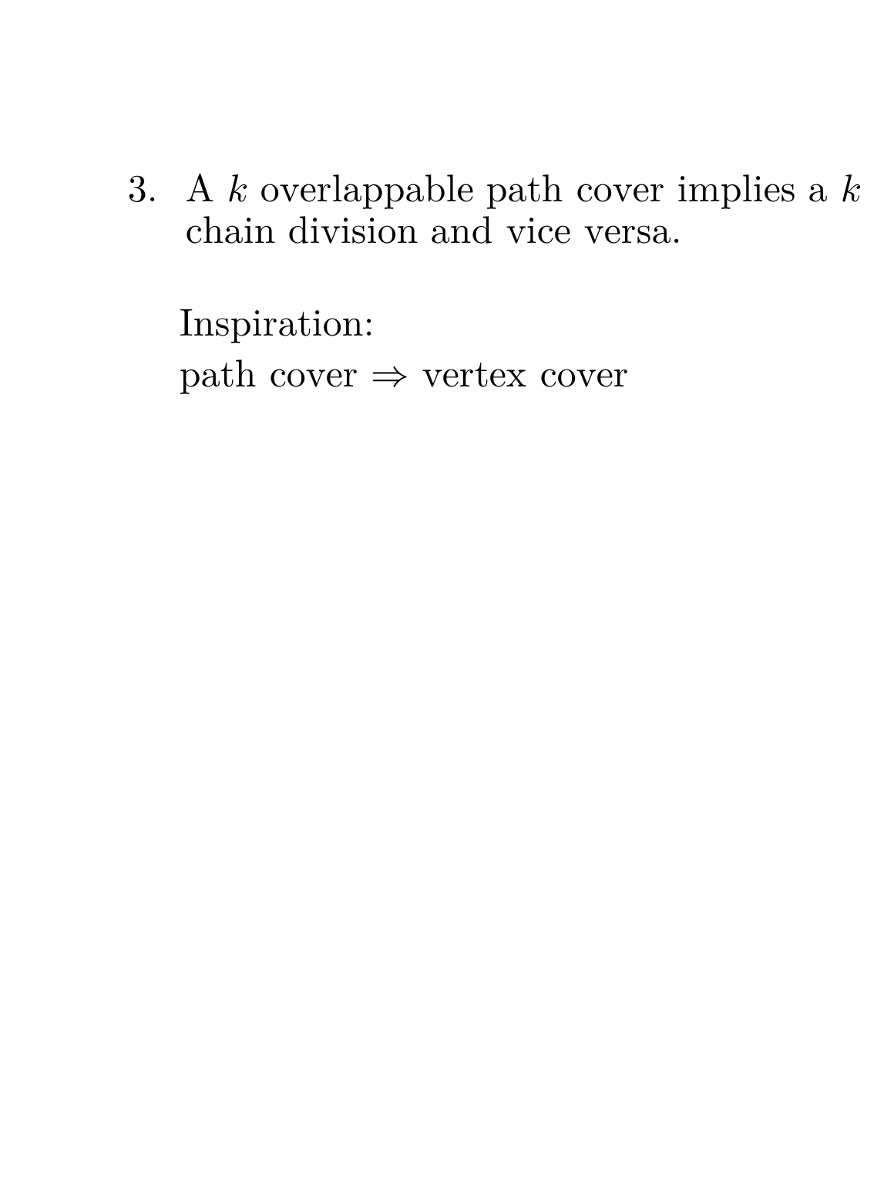
Observation
A $k$ overlappable path cover implies a $k$ chain division and vice versa.
Inspiration:
path cover $⇒$ vertex cover
Build a bipartite graph G to illustrate the possibilities.

Slide 10
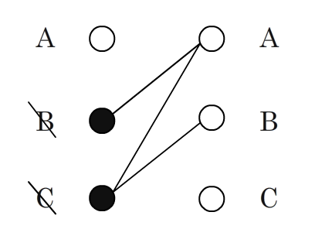
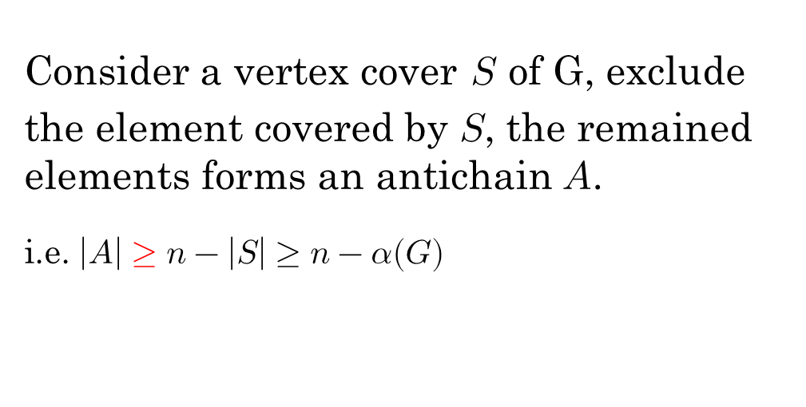
Proof
Consider a vertex cover $S$ of G, exclude the element covered by $S$, the remained elements forms an antichain $A$.
i.e. $\left|A\right|≥n−\left|S\right|≥n−α(G)$

Slide 11
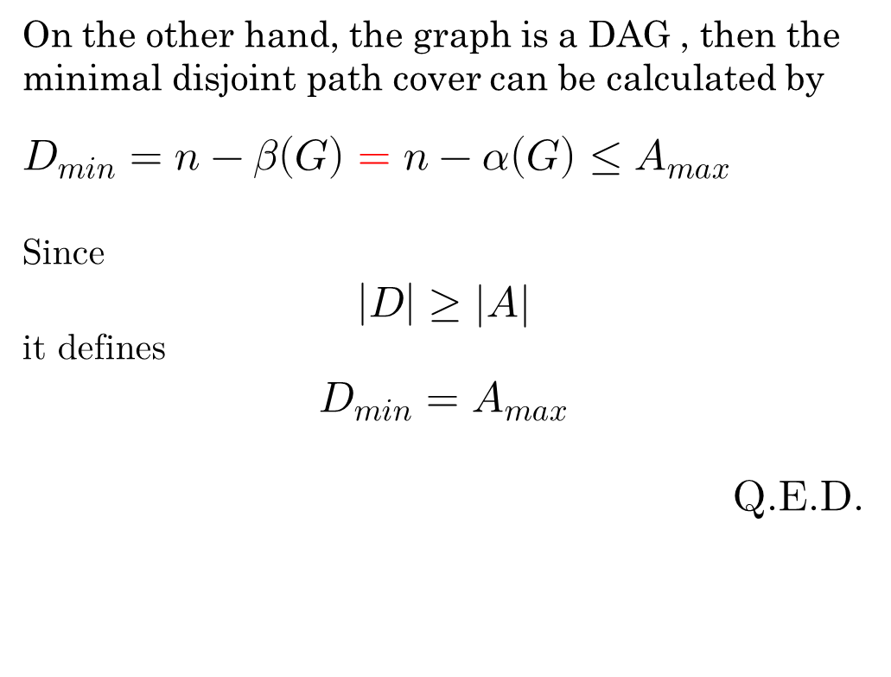
Proof
On the other hand, the graph is a DAG , then the
minimal disjoint path cover can be calculated by
$D_{min}=n−β\left(G\right)=n−α\left(G\right)≤A_{max}$
Since
$$\left|D\right|≥|A|$$
it defines
$$D_{min}=A_{max}$$
Q.E.D.

Slide 12
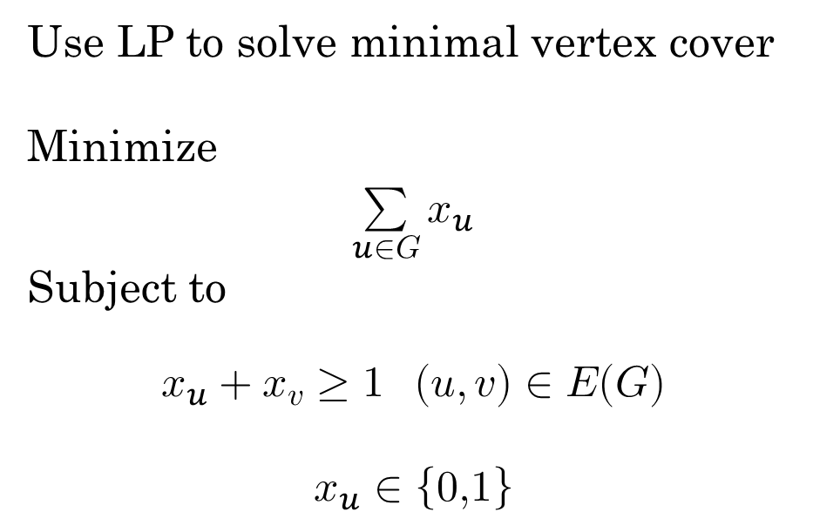
Primal-Dual Schema
Use LP to solve minimal vertex cover
Minimize
$$\sum_{u∈G}{x_{u}}$$
Subject to
$$x_{u}+x_{v}≥1 (u,v)∈E(G)$$
$$x_{u}∈\left\{0,1\right\}$$
Dual LP(ILP) ?

Slide 13

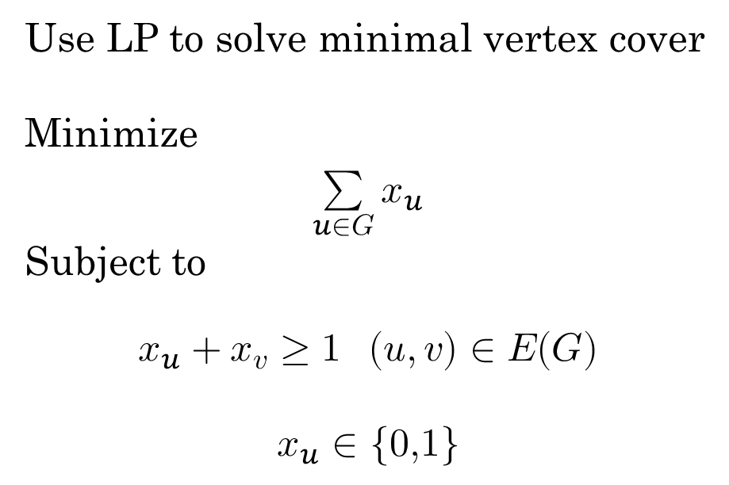
Primal-Dual Schema
Use LP to solve minimal vertex cover
Minimize
$$\sum_{u∈G}{x_{u}}$$
Subject to
$$x_{u}+x_{v}≥1 (u,v)∈E(G)$$
$$x_{u}∈\{0,1\}$$
Define a factor $α_{uv}≥0$
$$α_{uv}\left(x_{u}+x_{v}\right)≥α_{uv} (u,v)∈E(G)$$
Subject to
Maximize
$$\sum{α_{uv}}$$

Slide 14
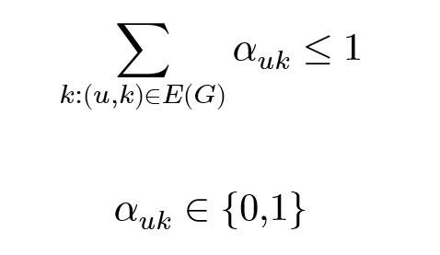

Primal-Dual Schema
If we only define edges once,
i.e.${ α}_{uv}$= $α_{vu}$
Maximize
$$\sum{α_{uv}}$$
Subject to
Thus, we have shown that matching problem
is a duality of vertex cover problem

Slide 15
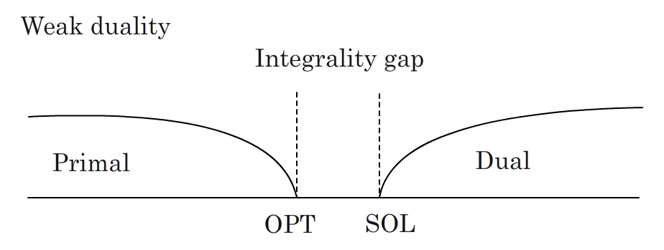
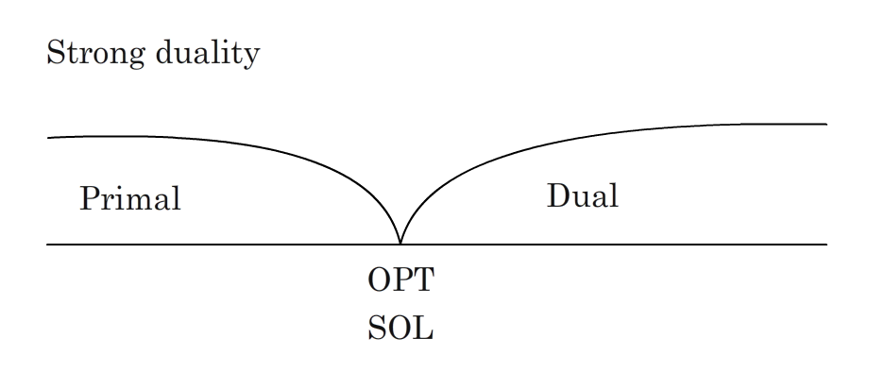
Primal-Dual Schema

Slide 16
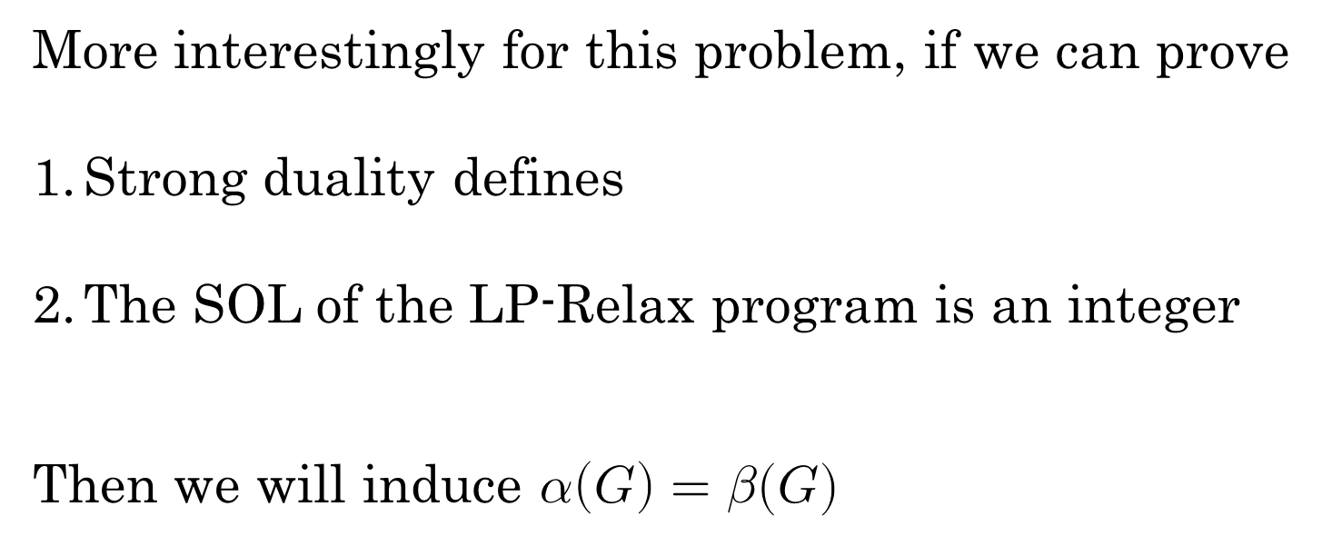
Primal-Dual Schema
More interestingly for this problem, if we can prove
Strong duality defines
The SOL of the LP-Relax program is an integer
Then we will induce $α\left(G\right)=β(G)$

