Slide 1
∑
Sum
2020.3.17 刘闵
Notes:
Part 1 Notation
1.a1+…+an
2.∑
3.Iverson
Part 2 Calculation
1.Sums and recurrences
Hanoi , general case, quick-sort
2.Manipulation of Sums
arithmetic progression, geometric progression, deriviation
3.Multiple sums
notation & law communicative law , matrix, example
4.Sums and integrals
example

Slide 2
Notation
ONE
∑

Slide 3
1.1 Three Dots Form
$$1+2+⋯+2^{n−1}$$
Explicit!
Combination between adjacent terms
too many details!
$$2^{0}+2^{1}+⋯+2^{n−1}$$

Slide 4
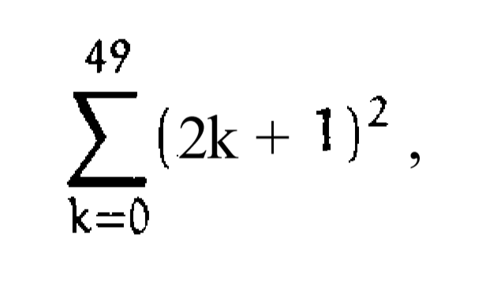
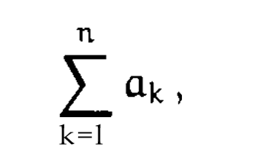
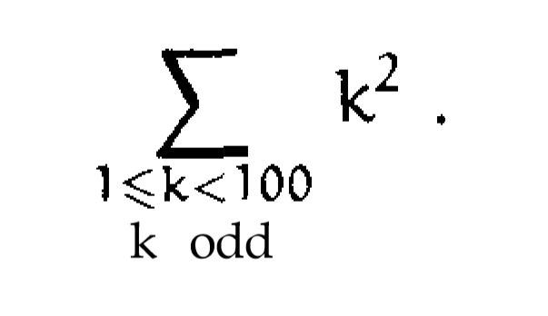
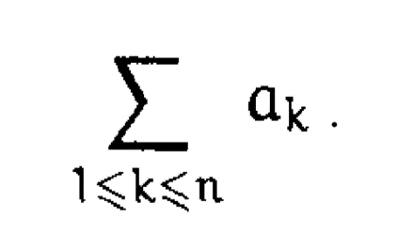
1.2 Sigma Notation
Sum of inconsequent numbers
Delimited form
General Sigma-Notation
Which is better?

Slide 5
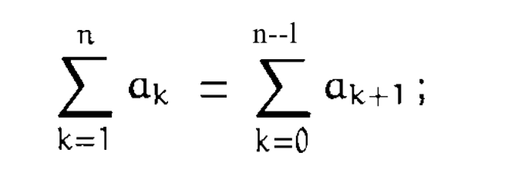
1.2 Sigma Notation
manipulation
Delimited form
General Sigma-Notation
Which is better?

Slide 6
1.2 Sigma Notation
$$\sum_{k=0}^{n}{k(k−1)(n−k)}$$
Zero terms are not generally harmful.
In fact, zeros often make t-manipulation easier.
－－ Concrete Mathematics
$$\sum_{k=2}^{n−1}{k(k−1)(n−k)}$$
ambiguous

Slide 7
1.3 Iverson’s Brackets
$$\left[P\right]=\left\{\begin{aligned}1 if P is true \\ 0 otherwise\end{aligned}\right.$$
Example: sum of reciprocal primes ≤ N
$$\sum_{p}{\left[p prime\right]\left[p≤N\right]/p}$$
What if p=0 ?
We do not need to fuss with boundary conditions.

Slide 8
1.3 Iverson’s Brackets
$$\sum_{k}{a_{k}[P(k)]}$$
Sometimes $a_{k}$ isn’t defined for all integers k.
We get around this difficulty by assuming that
[P(k)] is “ very strongly zero ” when P(k) is false;
it’s so much zero, it makes $a_{k}[P(k)]$equal to zero
even when $a_{k}$ is undefined.

Slide 9
$$a_{n}T_{n}=b_{n}T_{n−1}+c_{n}$$
TWO
Notes:
Part 2 Calculation
1.Sums and recurrences
Hanoi , general case, quick-sort
2.Manipulation of Sums
arithmetic progression, geometric progression, deriviation
3.Multiple sums
notation & law communicative law , matrix, example
4.Sums and integrals
example

Slide 10
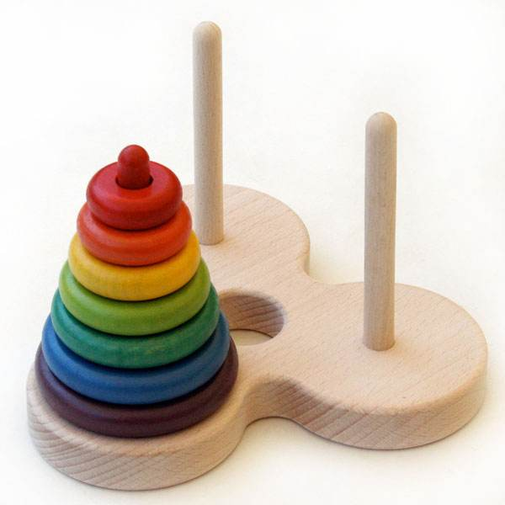
2.1 A Simple Example: Hanoi
$$\left\{\begin{aligned}T_{0}=0 \\ T_{n}=2T_{n−1}+1 for n>1\end{aligned}\right.$$

Slide 11
2.1 A Simple Example: Hanoi
$$\left\{\begin{aligned}T_{0}=0 \\ T_{n}=2T_{n−1}+1 for n>1\end{aligned}\right.$$
$\frac{T_{0}}{2^{0}}=0; \frac{T_{n}}{2^{n}}=\frac{T_{n−1}}{2^{n−1}}+\frac{1}{2^{n}},n>0$ (Let $S_{n}=\frac{T_{n}}{2^{n}}$)
$$S_{0}=0; S_{n}=S_{n−1}+2^{−n}=\sum_{k=1}^{n}{2^{−k}},n>0$$
$$S_{n}=1−{\left(\frac{1}{2}\right)}^{n}$$
$$T_{n}=2^{n}S_{n}=2^{n}−1$$

Slide 12
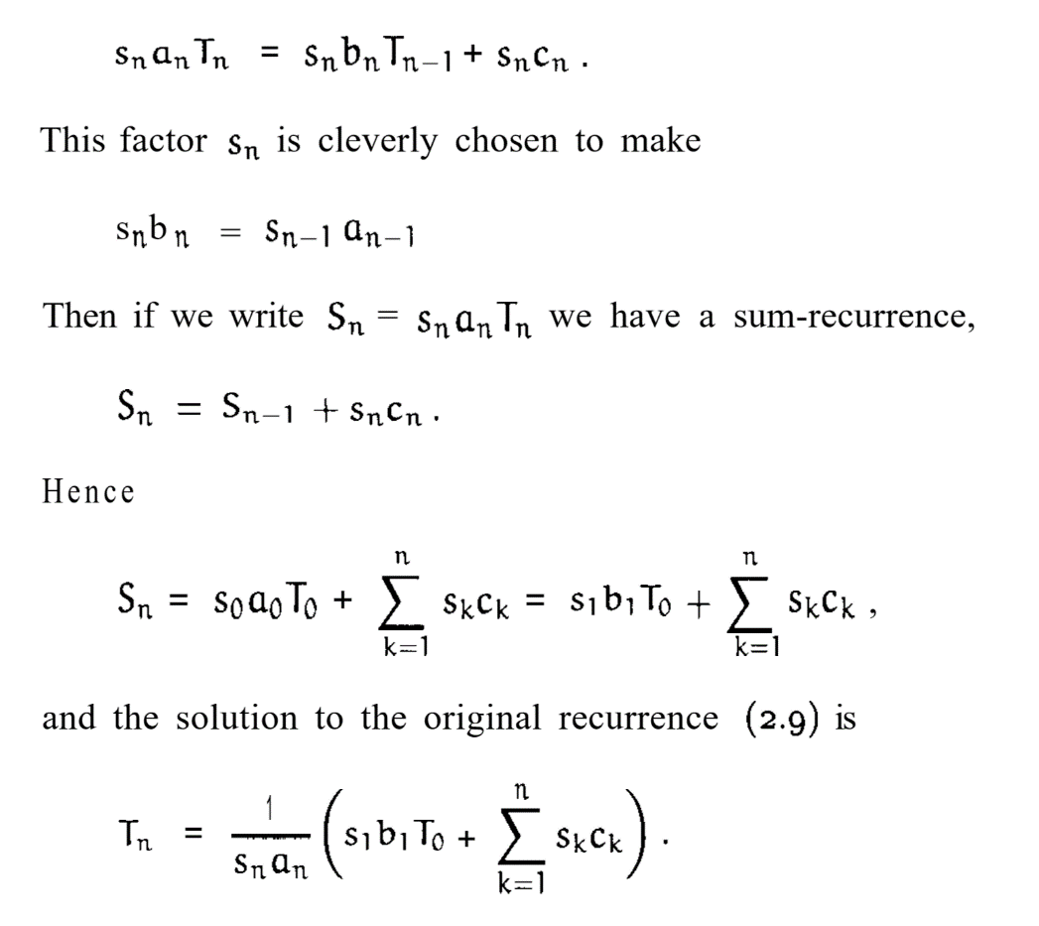
2.2 General Method For $a_{n}T_{n}=b_{n}T_{n−1}+c_{n}$:
$$a_{n}T_{n}=b_{n}T_{n−1}+c_{n}$$

Slide 13
2.3 $a_{n}T_{n}=b_{n}T_{n−1}+c_{n}$: Quick-sort
a more difficult example:
The average number of comparison steps made by quicksort
when it is applied to n items in random order satisfies the recurrence
Apply what we have learned.

Slide 14
2.3 $a_{n}T_{n}=b_{n}T_{n−1}+c_{n}$: Quick-sort
$$c_{0}$$
General Case

Slide 15
2.3 $a_{n}T_{n}=b_{n}T_{n−1}+c_{n}$: Quick-sort
not in closed form
We need to introduce $H_{n}$

Slide 16
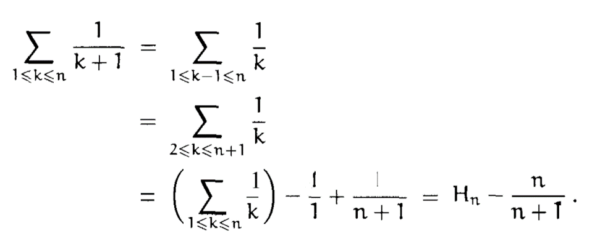
2.3 $a_{n}T_{n}=b_{n}T_{n−1}+c_{n}$: Quick-sort
harmonic number:
$$H_{n}=\sum_{k=1}^{n}{\frac{1}{k}}$$

Slide 17
Sum Manipulation
Three
Notes:
Part 2 Calculation
1.Sums and recurrences
Hanoi , general case, quick-sort
2.Manipulation of Sums
arithmetic progression, geometric progression, deriviation
3.Multiple sums
notation & law communicative law , matrix, example
4.Sums and integrals
example

Slide 18
3.1 Sum Manipulation: Operation Laws
$$S=\sum_{0≤k≤n}{\left(a+bk\right)}$$
Communicative law
arithmetic progression:
Associative law
“What’s one and one and one and one and one and one and one and one and one and one?”
“I don’t know,” said Alice. ‘I lost count.”
“She can’t do Addition.”
-Lewis Carroll [44]
Distributive law

Slide 19
3.1 Sum Manipulation: Operation Laws
We need to require only that there be exactly one integer k with p(k) = n when n is an element of the index set K.

Slide 20
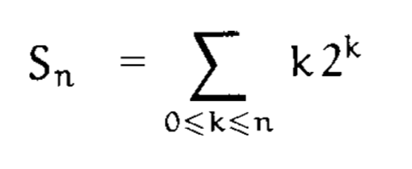
3.2 Sum Manipulation: Exercise
Exercise:
Perturbation method:
$$\sum_{k=1}^{m}{a_{k}}+\sum_{k=m}^{n}{a_{k}}=a_{m}+\sum_{k=1}^{n}{a_{k}}$$
$$\sum_{k=0}^{n}{a_{k}}=a_{0}+\sum_{k=1}^{n}{a_{k}}$$

Slide 21
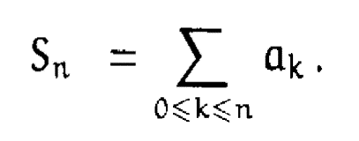
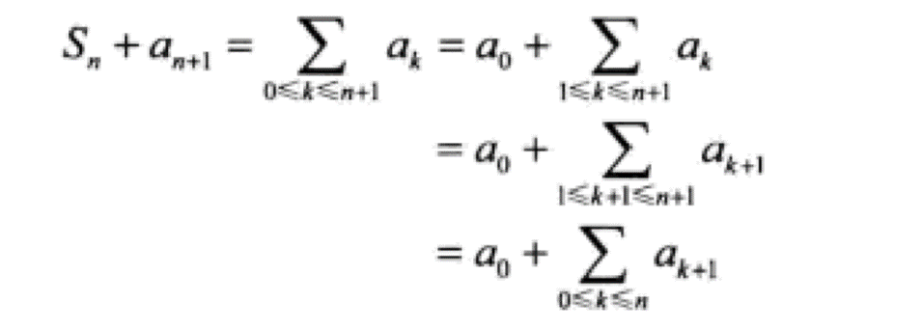
3.2 Sum Manipulation: Exercise
$$\sum_{0≤k≤n}{a_{k}}=a_{0}+\sum_{1≤k≤n}{a_{k}}$$
an unknown sum
Perturbation method:
evaluate a sum in closed form
$$S_{n}+\left(n+1\right)2^{n+1}=0∙2^{0}+\sum_{0≤k≤n}{(k+1)2^{k+1}}$$
express it in terms of S

Slide 22
3.2 Sum Manipulation: Exercise
Exercise:
Perturbation method:
Associative law:
$$2\sum_{0≤k≤n}{k2^{k}}=2S_{n}$$

Slide 23
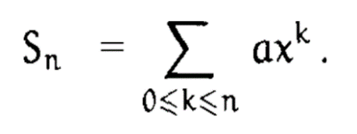
3.2 Sum Manipulation: Exercise
geometric progression:
Perturbation method:
$$\sum_{0≤k≤n}{ax^{k}}=\frac{a−ax^{n+1}}{1−x},x≠1$$

Slide 24
3.2 Sum Manipulation: Exercise
Exercise:
Perturbation method:
Associative law:
$$S_{n}+\left(n+1\right)2^{n+1}=2S_{n}+2(2^{n+1}−1)$$
…

Slide 25
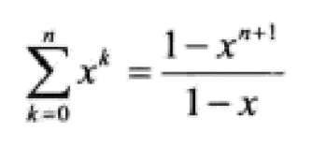
3.2 Sum Manipulation: Exercise
Exercise:

Slide 26
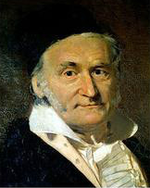
Multiple Sums
FOUR
Notes:
Part 2 Calculation
1.Sums and recurrences
Hanoi , general case, quick-sort
2.Manipulation of Sums
arithmetic progression, geometric progression, deriviation
3.Multiple sums
notation & law communicative law , matrix, example
4.Sums and integrals
example

Slide 27
3.1 Multiple Sums
two or more indices:

Slide 28
3.1 Multiple Sums
$$\sum_{j}{\sum_{k}{a_{j,k}[P(j,k)]}}$$
$$\sum_{j}{(\sum_{k}{a_{j,k}\left[P\left(j,k\right)\right]})}$$
Order!
abbreviation for
Summed first on k

Slide 29
3.1 Multiple Sums
Interchanging the order of summation
$$\sum_{j}{\sum_{k}{a_{j,k}\left[P\left(j,k\right)\right]}}=\sum_{P\left(j,k\right)}{a_{j,k}}=\sum_{k}{\sum_{j}{a_{j_{,}k}\left[P\left(j,k\right)\right]}}$$
Variations：
1. j and k are independent from each other!
2. the range of an inner sum depends on the index variable of the outer sum

Slide 30
3.1 Multiple Sums
Variation 1:
j and k are independent from each other!

Slide 31
3.1 Multiple Sums
Variation 2:
Example:
the range of an inner sum depends on the index variable of the outer sum
Condition:
P(j , k)

Slide 32
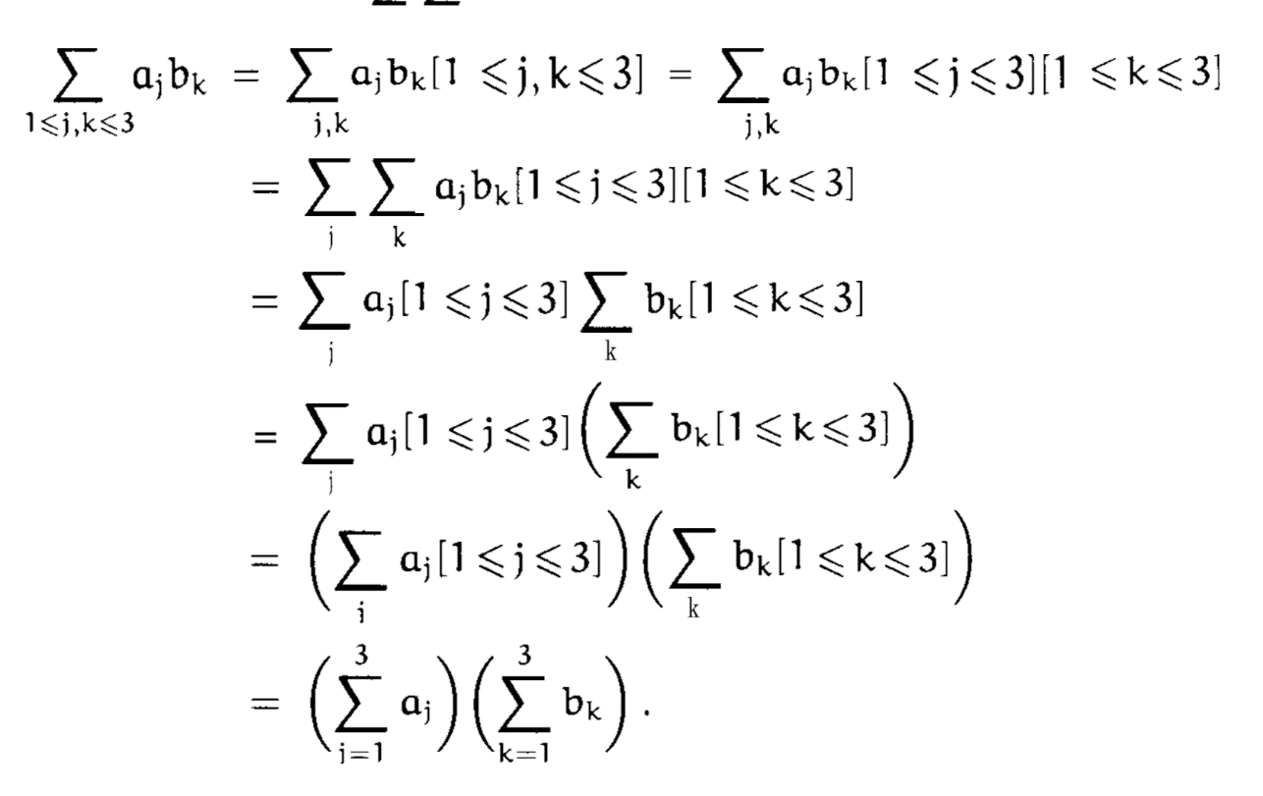
3.1 Multiple Sums
general distributive law
Distributive law
Distributive law
$$a_{1}b_{1}+a_{1}b_{2}+a_{1}b_{3}+a_{2}b_{1}+a_{2}b_{2}+a_{2}b_{3}+a_{3}b_{1}+a_{3}b_{2}+a_{3}b_{3}$$
$$=(a_{1}+a_{2}+a_{3})(b_{1}+b_{2}+b_{3})$$

Slide 33
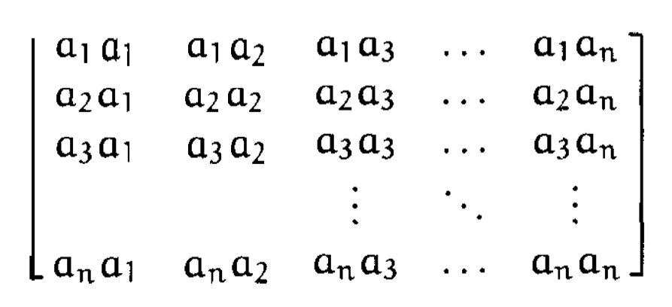
3.2 Multiple Sums: Practice
Find a simple formula for:

Slide 34
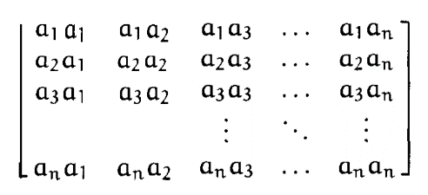
3.2 Multiple Sums: Practice
Rename (j, k) as (k, j)
$$=$$
general distributive law
$$a_{k}$$

Slide 35
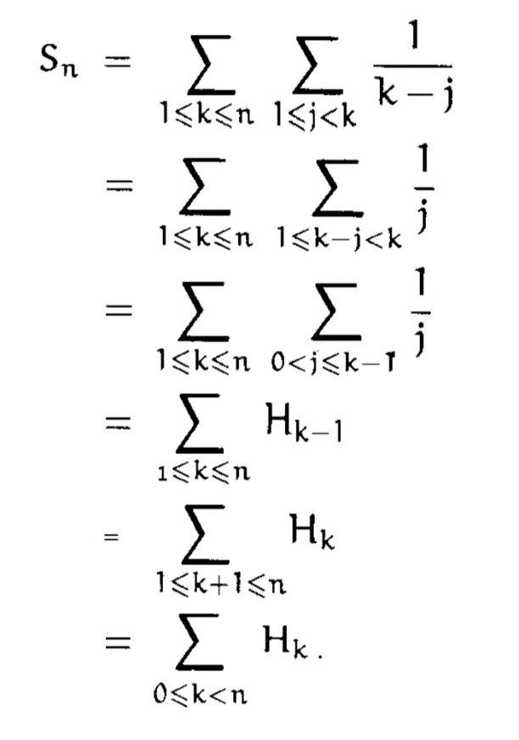
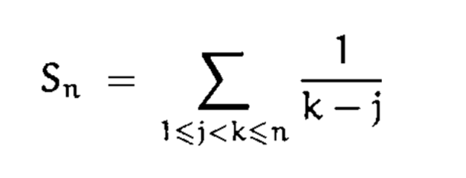
3.3 Multiple Sums: Exercise
Method 1
replace j by k - j
not in closed form

Slide 36
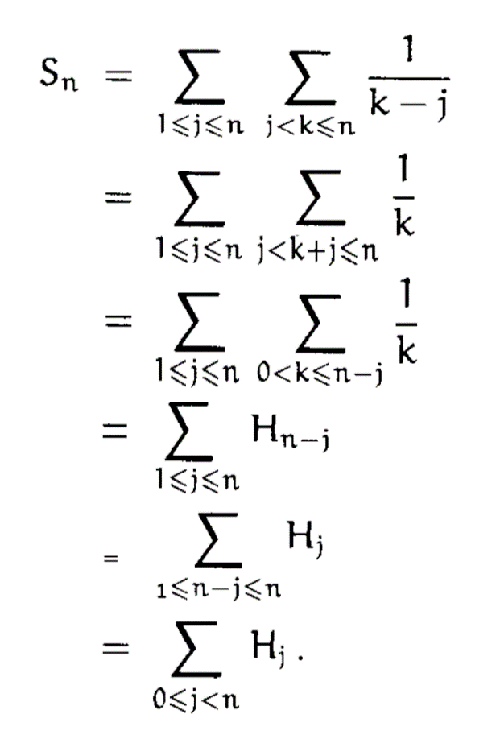
3.3 Multiple Sums: Exercise
Method 2
replace k by k + j
not in closed form

Slide 37
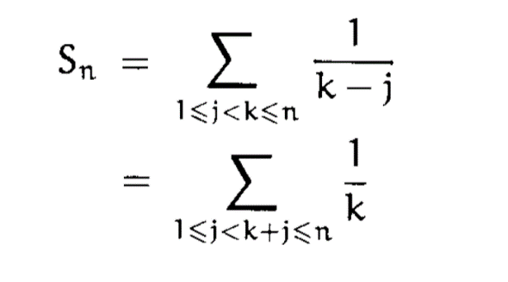
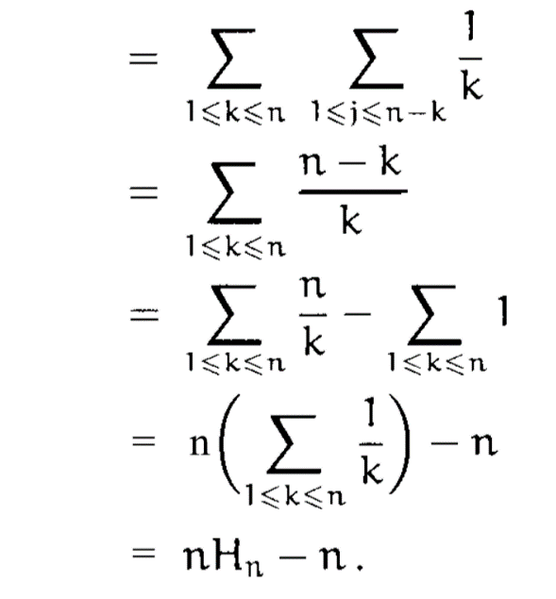
3.3 Multiple Sums: Exercise
Method 3
replace k by k + j
summed first on j
in closed form

Slide 38
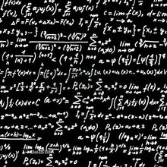
Sums & Integrals
FIVE
Notes:
Part 2 Calculation
1.Sums and recurrences
Hanoi , general case, quick-sort
2.Manipulation of Sums
arithmetic progression, geometric progression, deriviation
3.Multiple sums
notation & law communicative law , matrix, example
4.Sums and integrals
example

Slide 39
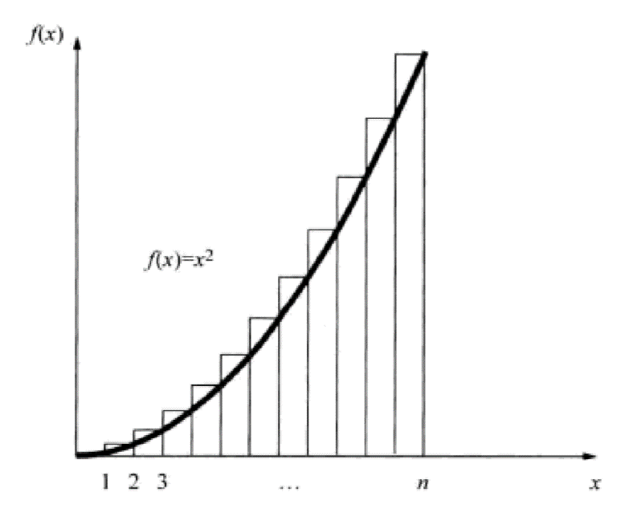
5 Replace Sums by Integrals
$$S_{n}=\sum_{k=0}^{n}{k^{2}}$$
$$S_{n}=S_{n−1}+n^{2}$$
We can find a simpler recurrence.

Slide 40
5 Replace Sums by Integrals
Method 1:
$$\int_{0}^{n}{x^{2}dx=\frac{n^{3}}{3}≈S_{n}}$$
$$E_{n}=S_{n}−\frac{n^{3}}{3}=S_{n−1}+n^{2}−\frac{n^{3}}{3}$$
$$=E_{n−1}+\frac{{(n−1)}^{3}}{3}+n^{2}−\frac{n^{3}}{3}$$
$$=E_{n−1}+n−\frac{1}{3}$$
Simpler!

Slide 41
5 Replace Sums by Integrals
Method 2:
arithmetic progression

Slide 42
Reference:
Graham R, Knuth D, Patashnik O. CONCRETE MATHEMATICS: 21-47
Acknowledgement:
Mr. ant & ant

Slide 43
∑
THANK YOU！
THAT’S THE END.

