Slide 1
Theorem 8.8 · Proof & Extension
金前程
2020/12/9

Slide 2
Theorem 8.8
For every graph G of order n containing no isolated vertices,
$$α(G)+β(G)=n$$
α(G) vertex independence number maximum number of vertices, no two of which are adjacent
β(G) vertex covering number minimum number of vertices that cover all edges of G

Slide 3
Before · Theorem 8.7
For every graph G of order n containing no isolated vertices,
$$α`\left(G\right)+β`(G)=n$$
α`(G) edge independence number maximum number of edges, no two of which are adjacent
β`(G) edge covering number minimum number of edges that cover all vertices of G

Slide 4
Theorem 8.7
How did we prove it?

Slide 5
Theorem 8.7
First
Suppose that $α`（G）=k$, covering 2k vertices
The left $n−2k$ vertices can be covered by $n−2k$ edges
These $n−k$ edges in total form an edge covering

Slide 6
Theorem 8.7
2
4
1
6
3
5
7
8
Red : edge independence
Red & Blue : edge cover
9

Slide 7
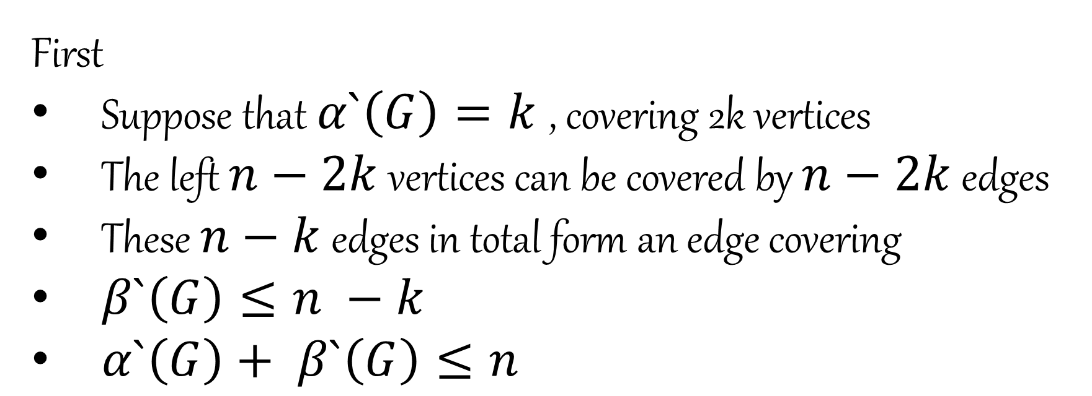
Theorem 8.7
First
Suppose that $α`（G）=k$, covering 2k vertices
The left $n−2k$ vertices can be covered by $n−2k$ edges
These $n−k$ edges in total form an edge covering
$β`（G）≤n −k$
$α`\left(G\right)+ β`（G）≤n$

Slide 8
Theorem 8.7
Then
Suppose that $β`（G）=k$
For subgraph$G\left(β\right)=g$, g has no trail T of length 3 (or even longer)
Every component of g is a star

Slide 9
Theorem 8.7
Corollary 4.6 : Every forest of order n with k components has size n − k.

Slide 10
Theorem 8.7
Then
Suppose that $β`（G）=k$
For subgraph$G\left(β\right)=g$, g has no trail T of length 3 (or even longer)
Every component of g is a star
There are $n−k$ components in g
From every component selecting an edge

Slide 11
Theorem 8.7
2
4
1
6
3
5
7
8
Red : edge independence
Red & Blue : edge cover
9

Slide 12
Theorem 8.7
Then
Suppose that $β`（G）=k$
For subgraph$G\left(β\right)=g$, g has no trail T of length 3 (or even longer)
Every component of g is a star
There are $n−k$ components in g
From every component selecting an edge
$α`\left(G\right)≥n −k$
$α`\left(G\right)+ β`\left(G\right)≥n$

Slide 13
Theorem 8.8
Can we apply the way we prove Theorem 8.7 again?

Slide 14
Theorem 8.8
First
Suppose that $α（G）=k$, for the maximal vertex independence A
The left $n−k$ vertices can form a vertex cover B

Slide 15
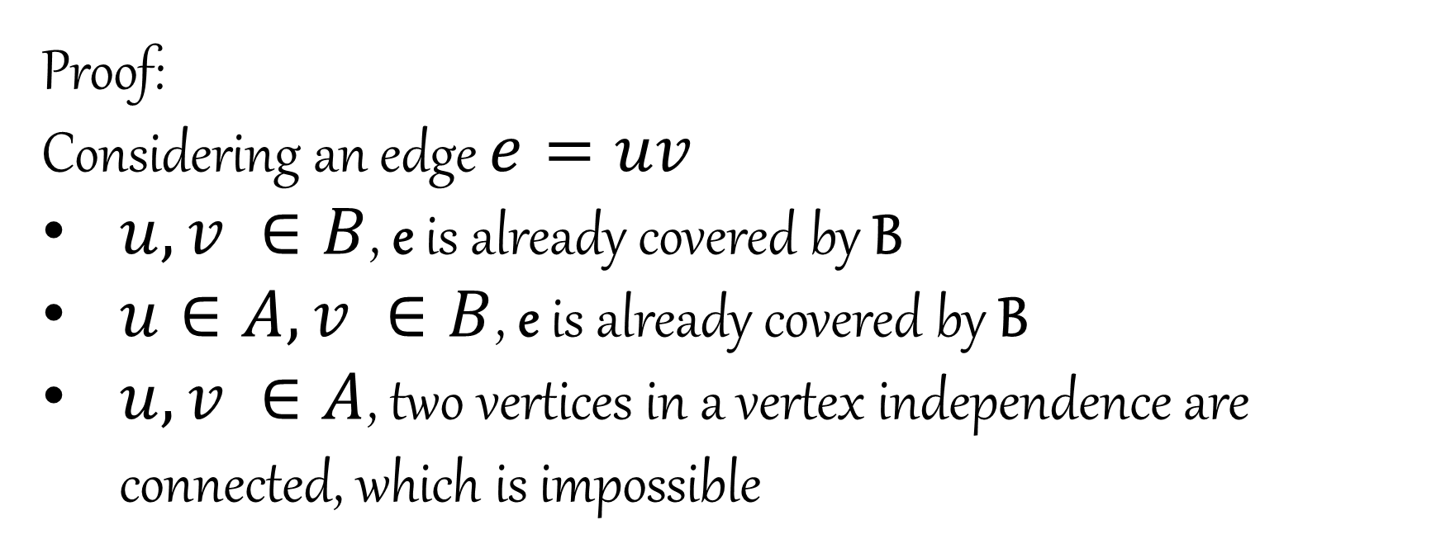
Theorem 8.8
Proof:
Considering an edge $e=uv$
$u, v ∈B$, e is already covered by B
$u∈A, v ∈B$, e is already covered by B
$u, v ∈A$, two vertices in a vertex independence are connected, which is impossible

Slide 16
Theorem 8.8
6
10
1
2
5
7
9
3
4
Red : vertex independence
Blue : vertex cover
8

Slide 17
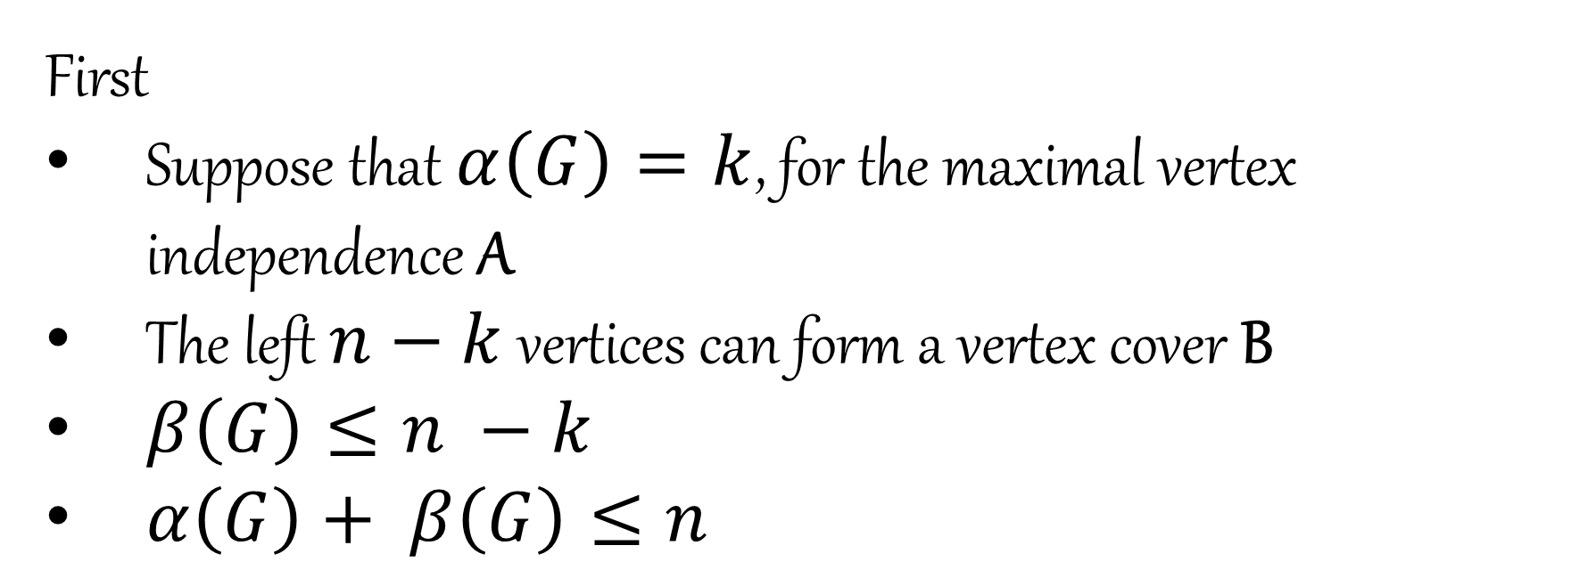
Theorem 8.8
First
Suppose that $α（G）=k$, for the maximal vertex independence A
The left $n−k$ vertices can form a vertex cover B
$β\left(G\right)≤n −k$
$α\left(G\right)+ β\left(G\right)≤n$

Slide 18
Theorem 8.8
Then
Suppose that $β（G）=k$, for the minimal vertex cover A
The left $n−k$ vertices can form a vertex independence B

Slide 19
Theorem 8.8
Proof:
If there exists an edge $e=uv, u, v ∈B$
e is not covered by A
Contradiction!
None of two vertices are connected in B

Slide 20
Theorem 8.8
6
10
1
2
5
7
9
3
4
Red : vertex independence
Blue : vertex cover
8

Slide 21
Theorem 8.8
Then
Suppose that $β（G）=k$, for the minimal vertex cover A
The left $n−k$ vertices can form a vertex independence B
$β\left(G\right) ≥n −k$
$α\left(G\right)+β\left(G\right) ≥n$

Slide 22
Theorem 8.8 · Further
Recall how we prove Theorem 8.8, we find that:
For any vertex independence A, V – A is a vertex cover
For any vertex cover B, V – B is a vertex independence
Obviously, the relationship between vertex independence and vertex cover is Bijective.

Slide 23
Compare
Edge independence & cover
Edge independence is a subset of a edge cover
$α`\left(G\right)≤ β`(G)$
$α`\left(G\right)= β`(G)$ , iff G has a perfect matching
Vertex independence & cover
The complement of vertex independence is a vertex cover and so is vertex cover
$α\left(G\right)≤ β(G)$
$α\left(G\right)= β(G)$ , iff G has a perfect matching

Slide 24
Compare
Matching or Matched?

Slide 25
König Theorem
$$α`\left(G\right)=β(G)$$
$$α\left(G\right)=β`(G)$$

Slide 26
Reference
A First Course in Graph Theory : Gary Chartrand & Ping Zhang
Edge Independence and Edge Cover : Gong Cheng
Thanks for the help of Teacher Ma & Dalao Lin

Slide 27
End
Sincerely Thank You For Listening

