Slide 1
问题求解
习题讲解1-3

Slide 2
题目 4 (改编自 UD Problem 18.20 与 UD Problem 18.26)

Slide 3
题目 4 (改编自 UD Problem 18.20 与 UD Problem 18.26)
1st: $\left(p\left(1\right)∧∀n\left(p\left(n\right)→p\left(n+1\right)\right)\right)→∀nP\left(n\right)$

Slide 4
题目 4 (改编自 UD Problem 18.20 与 UD Problem 18.26)
2nd: $\left(p\left(1\right)∧∀n\left(\left(p\left(1\right)∧p\left(2\right)∧…∧p\left(n\right)\right)→p\left(n+1\right)\right)\right)→∀nP\left(n\right)$

Slide 5
题目 4 (改编自 UD Problem 18.20 与 UD Problem 18.26)
1st: $\left(p\left(1\right)∧∀n\left(p\left(n\right)→p\left(n+1\right)\right)\right)→∀nP\left(n\right)$
2nd: $\left(p\left(1\right)∧∀n\left(\left(p\left(1\right)∧p\left(2\right)∧…∧p\left(n\right)\right)→p\left(n+1\right)\right)\right)→∀nP\left(n\right)$
1st⬅2nd
已知：
2nd: $\left(p\left(1\right)∧∀n\left(\left(p\left(1\right)∧p\left(2\right)∧…∧p\left(n\right)\right)→p\left(n+1\right)\right)\right)→∀nP\left(n\right)$
$p\left(1\right)$
$∀n\left(p\left(n\right)→p\left(n+1\right)\right)$
欲证明：$∀nP\left(n\right)$

Slide 6
题目 4 (改编自 UD Problem 18.20 与 UD Problem 18.26)
1st⬅2nd
已知：
2nd: $\left(p\left(1\right)∧∀n\left(\left(p\left(1\right)∧p\left(2\right)∧…∧p\left(n\right)\right)→p\left(n+1\right)\right)\right)→∀nP\left(n\right)$
$p\left(1\right)$
$∀n\left(p\left(n\right)→p\left(n+1\right)\right)$
欲证明：$∀nP\left(n\right)$
证明：
$∀n\left(p\left(n\right)→p\left(n+1\right)\right)$ => $∀n\left(\left(p\left(1\right)∧p\left(2\right)∧…∧p\left(n\right)\right)→p\left(n+1\right)\right)$
由2nd可知$∀nP\left(n\right)$
证毕

Slide 7
题目 4 (改编自 UD Problem 18.20 与 UD Problem 18.26)
1st: $\left(p\left(1\right)∧∀n\left(p\left(n\right)→p\left(n+1\right)\right)\right)→∀nP\left(n\right)$
2nd: $\left(p\left(1\right)∧∀n\left(\left(p\left(1\right)∧p\left(2\right)∧…∧p\left(n\right)\right)→p\left(n+1\right)\right)\right)→∀nP\left(n\right)$
1st➔2nd
已知：
1st: $\left(p\left(1\right)∧∀n\left(p\left(n\right)→p\left(n+1\right)\right)\right)→∀nP\left(n\right)$
$p\left(1\right)$
$∀n\left(\left(p\left(1\right)∧p\left(2\right)∧…∧p\left(n\right)\right)→p\left(n+1\right)\right)$
欲证明：$∀nP\left(n\right)$

Slide 8
题目 4 (改编自 UD Problem 18.20 与 UD Problem 18.26)
1st➔2nd
已知：
1st: $\left(p\left(1\right)∧∀n\left(p\left(n\right)→p\left(n+1\right)\right)\right)→∀nP\left(n\right)$
(2) $q\left(1\right)$
(3) $∀n\left(\left(q\left(1\right)∧q\left(2\right)∧…∧q\left(n\right)\right)→q\left(n+1\right)\right)$
欲证明：$∀nq\left(n\right)$
证明：
令$p\left(n\right)=\left(q\left(1\right)∧q\left(2\right)∧…∧q\left(n\right)\right)$
则（3）可写为$∀n\left(p\left(n\right)→q\left(n+1\right)\right)$;
我们目标：$∀n\left(p\left(n\right)→p\left(n+1\right)\right)$
由$p\left(n\right)→q\left(n+1\right)可得p\left(n\right)→p\left(n\right)∧q\left(n+1\right)即为p\left(n\right)→p\left(n+1\right)$
由1st可知$∀nP\left(n\right)成立$，进一步可得$∀nq\left(n\right)$

Slide 9
题目 4 (改编自 UD Problem 18.20 与 UD Problem 18.26)
反证法：
假设存在自然数非空集合S，且S不包含最小元素
则其补集T=N-S
显然$1∉S$,否则1必然是S的最小元素，所以$1∈T；$
如果$1,2，…,k∈T，$则$k+1∈T$；否则$k+1∈S$，并且为S中的最小元素；
由第二数学归纳法可得T=N；所以S为空集，与假设矛盾，假设不成立。
证毕。

Slide 10
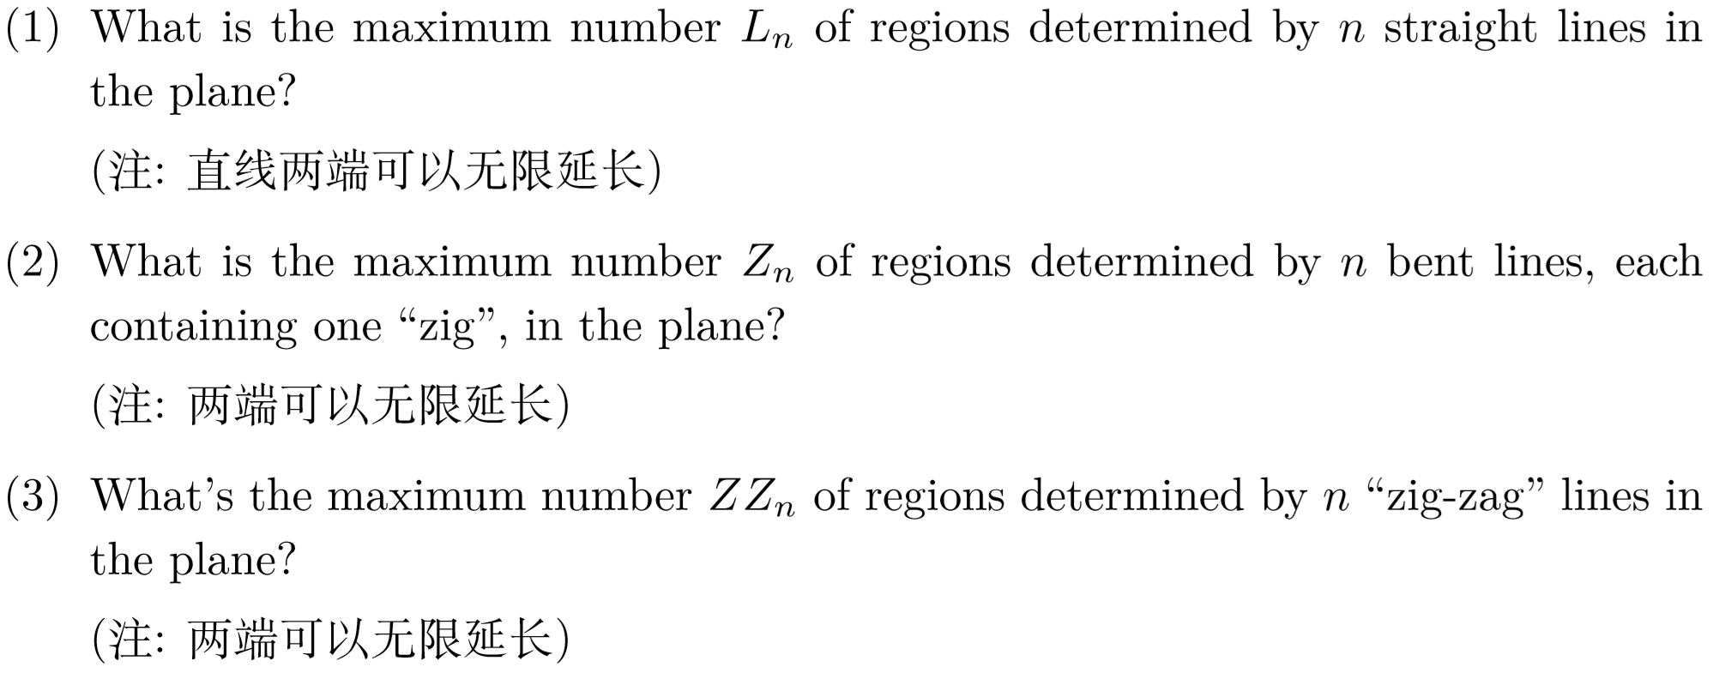
$$L_{n}=L_{n−1}+n$$
$$L_{n}=1+\frac{n\left(n+1\right)}{2}$$
$$Z_{n}=L_{2n}−2n$$
$$Z_{n}=2n^{2}−n+1$$
$${ZZ}_{n}=ZZ_{n−1}+8\left(n−1\right)+n$$
$${ZZ}_{n}=L_{n}+8\left(\begin{aligned}n \\ 2\end{aligned}\right)$$

Slide 11
题目 8 (ES Problem 24.7: Monotone Subsequence)
Find a sequence of nine distinct integers that does not contain a monotone subsequence of length four.
Generalize your construction by showing how to construct (for every positive integer $n$) a sequence of $n^{2}$ distinct integers that does not contain a monotone subsequence of length $n + 1$.
3 | 2 | 1
6 | 5 | 4
9 | 8 | 7

Slide 12
题目 8 (ES Problem 24.7: Monotone Subsequence)
Find a sequence of nine distinct integers that does not contain a monotone subsequence of length four.
Generalize your construction by showing how to construct (for every positive integer $n$) a sequence of $n^{2}$ distinct integers that does not contain a monotone subsequence of length $n + 1$.
$$c1$$ | $$c2$$ | $$…$$ | $$cn$$
$$r1$$
$$r2$$
… … …
$$rn$$
确保第i+1排的每个数字比第i排的每个数字都大
每一排递减排序

Slide 13
题目 9 (Numbers)
显然2k-1与2k是互质的
我们构建n个笼子，每个笼子包含两个数$\left\{2k−1,2k\right\},k=\left\{1,2,…,n\right\}$
我们从$2n$个数中选取$n+1$个数，必然有两个数来自同一个笼子

Slide 14
题目 9 (Numbers)
1~2n每个数都可以表示为$\left(2k+1\right)2^{r}$的形式
为此我们可以构建$n$个笼子，第$i$个笼子里放形如$\left(2i+1\right)2^{r}$的数；
选择$n+1$个数，必然有两个数来自同一个笼子；则他们必然存在整除关系

