Slide 1
Delta Stepping Algorithm
林荣恩
Nanjing University

Slide 2
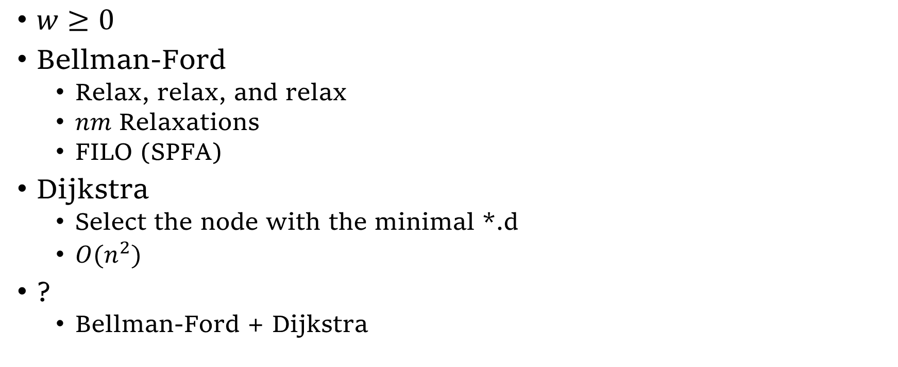
Single-source Shortest Paths Problem
$w≥0$
Bellman-Ford
Relax, relax, and relax
$nm$ Relaxations
FILO (SPFA)
Dijkstra
Select the node with the minimal *.d
$O(n^{2})$
?
Bellman-Ford + Dijkstra

Slide 3
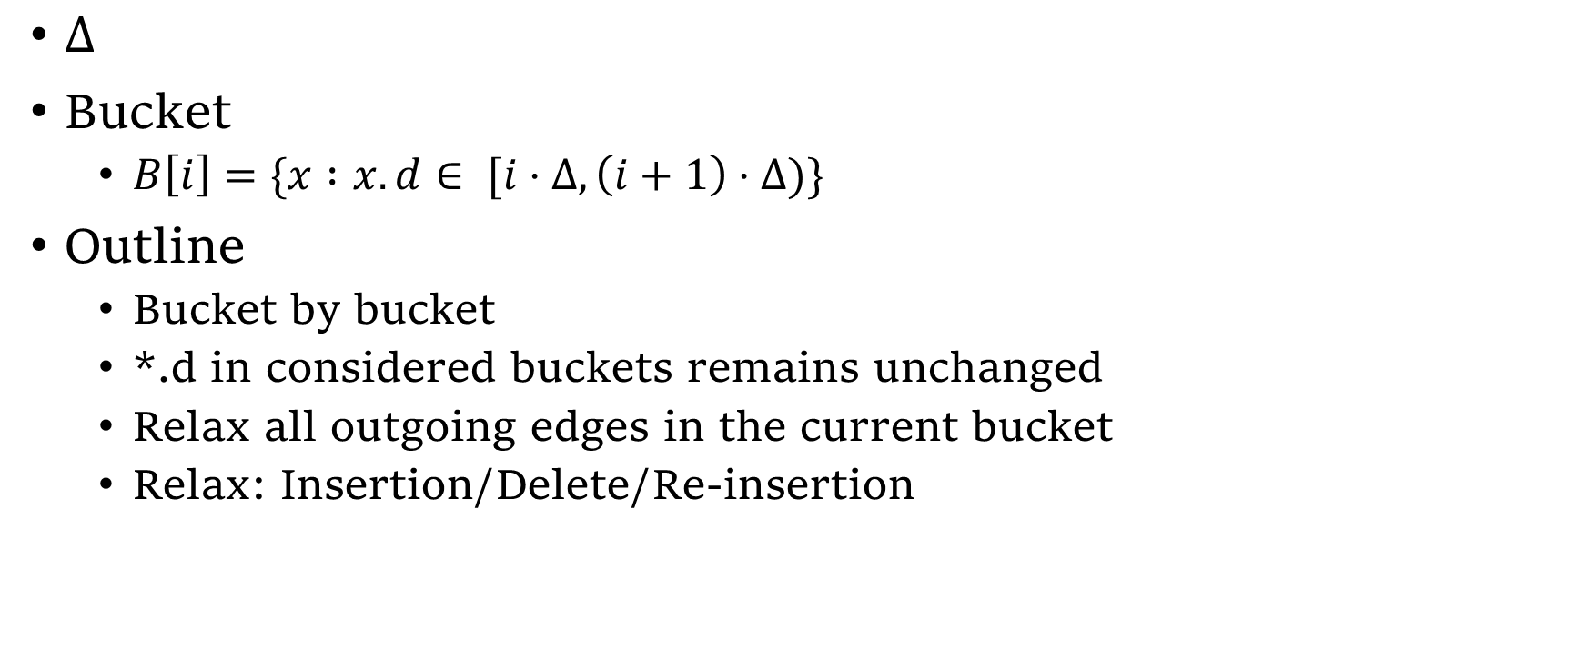
Delta Stepping Algorithm
$Δ$
Bucket
$B\left[i\right]=\{x :x.d∈ [i⋅Δ,\left(i+1\right)⋅Δ)\}$
Outline
Bucket by bucket
*.d in considered buckets remains unchanged
Relax all outgoing edges in the current bucket
Relax: Insertion/Delete/Re-insertion
Notes:
Relax 会把后面 Bucket 的点往前推；

Slide 4
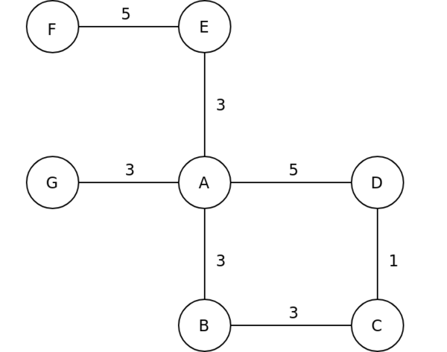
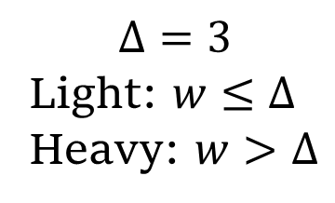
Example
$$Δ=3$$
Light: $w≤Δ$
Heavy: $w>Δ$

Slide 5
(Aborted)
*.d | A | B | C | D | E | F | G | B $$Δ=3$$ | [0,2] | [3,5] | [6,8]
 | $$0$$ | $$∞$$ | $$∞$$ | $$∞$$ | $$∞$$ | $$∞$$ | $$∞$$ |  | $$\{A\}$$
 | $$0$$ | $$3$$ | $$∞$$ | $$5$$ | $$3$$ | $$∞$$ | $$3$$ |  | $$\{A\}$$ | $$\{B,D,E,G\}$$
 | $$0$$ | $$3$$ | $$6$$ | $$5$$ | $$3$$ | $$8$$ | $$3$$ |  |  |  | $$\{C,F\}$$

Slide 6

Comparison
Special Cases
$Δ=1$ : Dijkstra
$Δ≥max⁡(∗.d)$ : Bellman-Ford

Slide 7

Space Complexity
At most $⌈\frac{\max_{i∈E}{w_{i}}}{Δ}⌉$ buckets

Slide 8

Time Complexity*
Notation
$Δ$
$L=\max\left\{∗.d\right\}$
$(Δ$-path) $p^{Δ}$ : $\sum_{i∈p}{w_{i}}≤Δ$
$C_{Δ}=\left\{\left\langle u,v\right\rangle :∃p^{Δ}=\left(u,…,v\right)\right\}$
$C_{Δ+}=\left\{\left\langle u,v,w\right\rangle :\left(u,v\right)∈C_{Δ}\text{∧}\left(v,w\right) \text{is} \text{light}\right\}$
$O(n+m+\left|C_{Δ}\right|+\left|C_{Δ+}\right|+\frac{L}{Δ})$
Heavy-Relaxation
Re-insertion
Re-relaxation
Notes:
像 Dijk 一样说明，Re-insertion 与 C_\Delta 中元素存在单射.

Slide 9

Comparison
$$L=\max\left\{∗.d\right\}$$
$$C_{Δ}=\left\{\left\langle u,v\right\rangle :∃p^{Δ}=\left(u,…,v\right)\right\}$$
$$C_{Δ+}=\left\{\left\langle u,v,w\right\rangle :\left(u,v\right)∈C_{Δ}\text{∧}\left(v,w\right) \text{is} \text{light}\right\}$$
$Δ$ : $O\left(n+m+\left|C_{Δ}\right|+\left|C_{Δ+}\right|+\frac{L}{Δ}\right)$
Select a good $Δ$ (e.g. $Δ=\frac{1}{d}$)
Bellman-Ford : $O(nm)$
Dijkstra : $O(n\log{n})$ !
“Sequential”

Slide 10
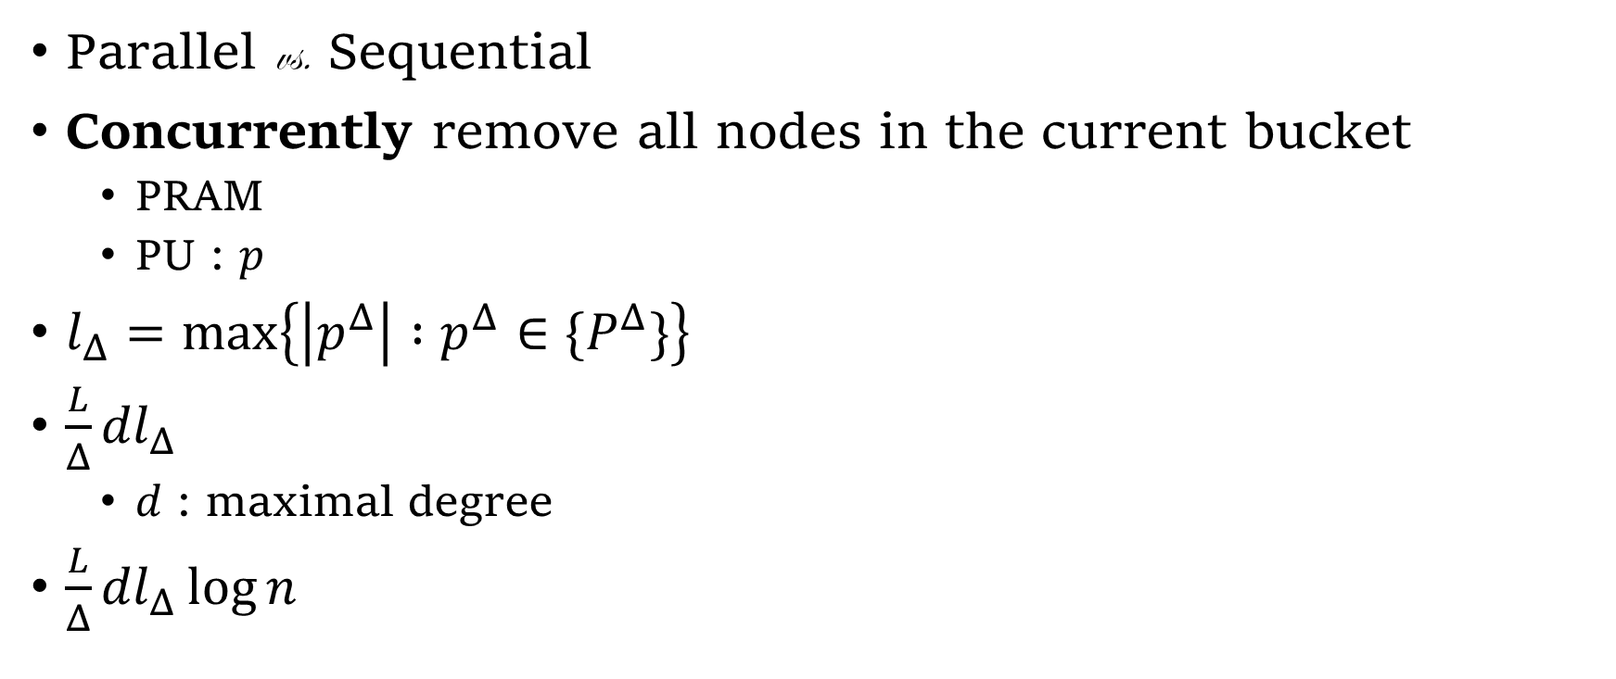
Parallel !
Parallel vs. Sequential
Concurrently remove all nodes in the current bucket
PRAM
PU : $p$
$l_{Δ}=\max\left\{\left|p^{Δ}\right| :p^{Δ}∈\{P^{Δ}\}\right\}$
$\frac{L}{Δ}{dl}_{Δ}$
$d$ : maximal degree
$\frac{L}{Δ}{dl}_{Δ}\log{n}$
Notes:
每块中最多更新次数 (Parallel; Bellman-Ford); log可能来自PRAM

Slide 11

Parallel !
$\frac{L}{Δ}{dl}_{Δ}\log{n}$
$p=\left\lceil \frac{n+m+\left|C_{Δ}\right|+\left|C_{Δ+}\right|}{\frac{L}{Δ}dl_{Δ}\log{n}}\right\rceil <n$
$O\left(\frac{n+m+\left|C_{Δ}\right|+\left|C_{Δ+}\right|}{p}+\frac{L}{Δ}dl_{Δ}\log{n}\right)=O\left(\frac{L}{Δ}dl_{Δ}\log{n}\right)$
Notes:
为什么不超过n?

Slide 12
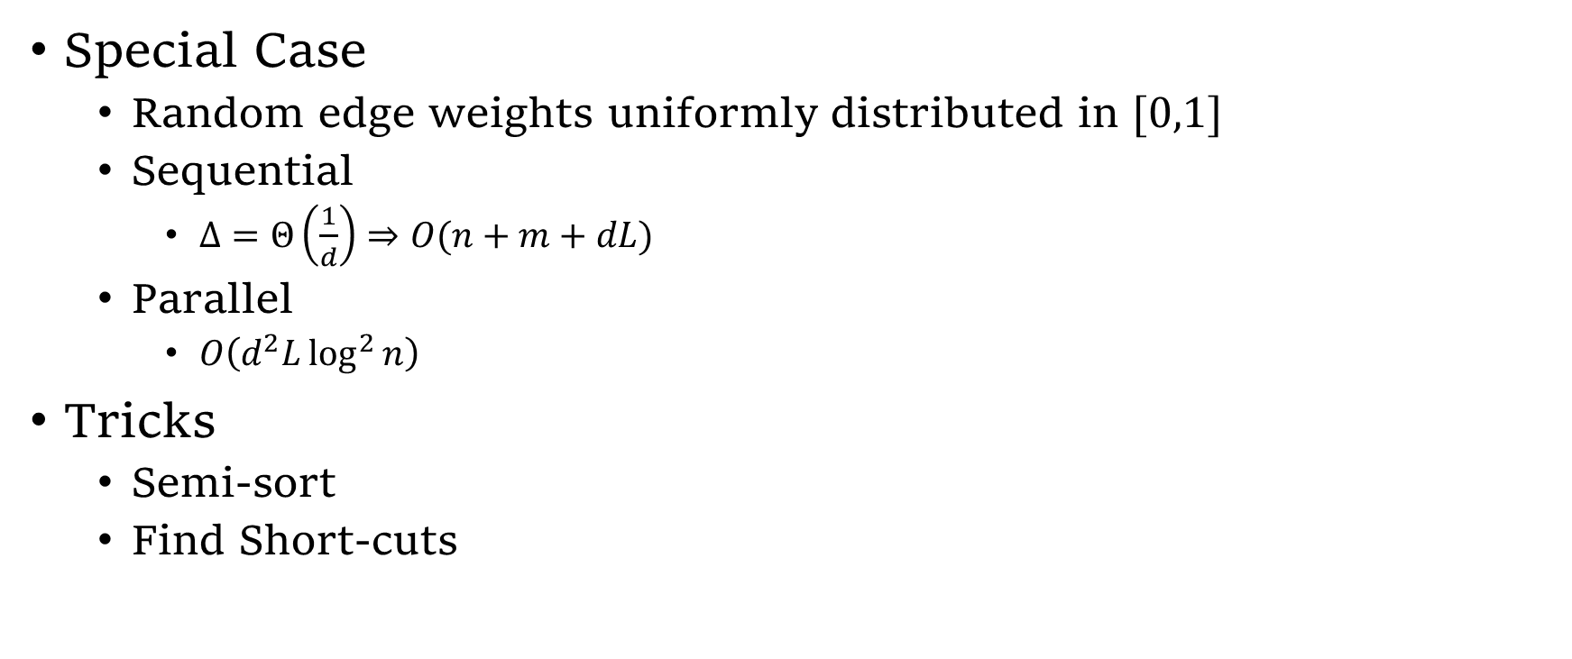
Other Results
Special Case
Random edge weights uniformly distributed in $[0,1]$
Sequential
$Δ=Θ\left(\frac{1}{d}\right)⇒O(n+m+dL)$
Parallel
$O\left(d^{2}L\log^{2}{n}\right)$
Tricks
Semi-sort
Find Short-cuts

Slide 13
Q & A

