Slide 1
Average-case Analysis of FindMax
金前程
2020. 4. 21

Slide 2
Description of the Algorithm
For X[1], X[2], … , X[n] and they are all different from each other, find m that m = $\max_{1≤i≤n}{X[i]}$

Slide 3
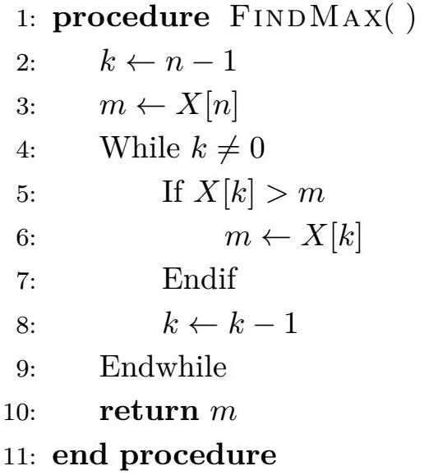
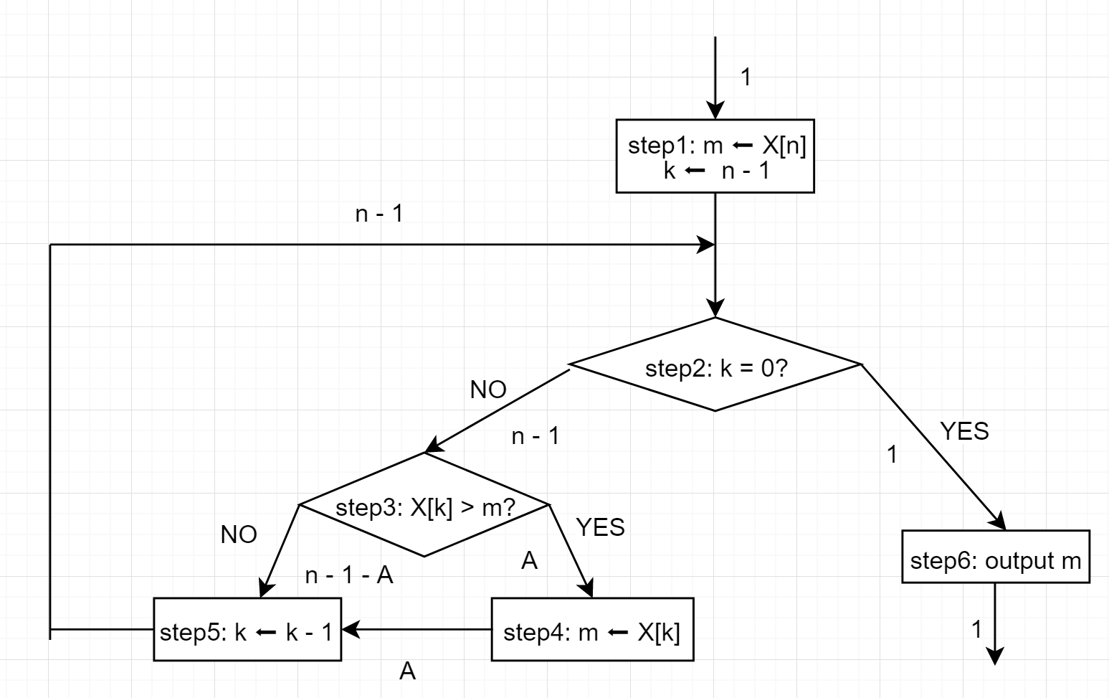
Flowchart
Pseudocode

Slide 4
Step1: 1
Step2: 1
Step3: n - 1
Step4: A
Step5: n – 1
Step6: 1

Slide 5
How to analyze A?
MIN
MAX
AVE(平均值)
DEV(标准差)
0
n - 1
?
?

Slide 6
Example
n = 3
X = {1, 2, 3} A = 0
X = {1, 3, 2} A = 1
X = {2, 1, 3} A = 0
X = {2, 3, 1} A = 1
X = {3, 1, 2} A = 1
X = {3, 2, 1} A = 2
Definition:
$P_{n, k}$ as the amount of permutations
if A = k with n elements in X and
$p_{n, k}$ as the probability of these
permutations among all

Slide 7
Example
n = 3
X = {1, 2, 3} A = 0
X = {1, 3, 2} A = 1
X = {2, 1, 3} A = 0
X = {2, 3, 1} A = 1
X = {3, 1, 2} A = 1
X = {3, 2, 1} A = 2
$$p_{n,k}= \frac{P_{n,k}}{n!}$$
${Ave}_{n}= \sum_{k=1}^{n}{kp_{n,k}}$(平均值)
${Var}_{n}= \sum_{k=1}^{n}{{(k−A_{n})}^{2}p_{n,k}}$(方差)
In this situation, we get:
${Ave}_{n}=$ 2/6 * 0 + 3/6 * 1 + 1/6 * 2 = 5/6
$${Var}_{n}=101/108$$

Slide 8
Example
n = 3
X = {1, 2, 3} A = 0
X = {1, 3, 2} A = 1
X = {2, 1, 3} A = 0
X = {2, 3, 1} A = 1
X = {3, 1, 2} A = 1
X = {3, 2, 1} A = 2
$${Var}_{n}= \sum_{k=1}^{n}{{(k−{Ave}_{n})}^{2}p_{n,k}}$$
= $\sum_{k=1}^{n}{k^{2}p_{n,k}−{\sum_{k=1}^{n}{2kAve}}_{n}p_{n,k}+{{Ave}_{n}}^{2}}$
= $\sum_{k=1}^{n}{k^{2}p_{n,k}}$ - ${{Ave}_{n}}^{2}$
$${Dev}_{n}= \sqrt{V_{n}}= \sqrt{\sum_{k=1}^{n}{k^{2}p_{n,k}} \text{− }{{Ave}_{n}}^{2}}$$

Slide 9
How about n = 4?
{1}:$\left\{\begin{aligned}\text{\{1, }\text{2}\text{, }\text{3}\text{\}} \text{A}\text{ = 0} \\ \text{\{1, }\text{3}\text{, }\text{2}\text{\}} \text{A}\text{ = 1} \\ \text{\{}\text{2}\text{, }\text{1}\text{, }\text{3}\text{\}} \text{A}\text{ = 0} \\ \text{\{}\text{2}\text{, }\text{3}\text{, }\text{1}\text{\}} \text{A}\text{ = 1} \\ \text{\{}\text{3}\text{, }\text{1}\text{, }\text{2}\text{\}} \text{A}\text{ = 1} \\ \text{\{}\text{3}\text{, }\text{2}\text{, }\text{1}\text{\}} \text{A}\text{ = 2}\end{aligned}\right.$
{3}:$\left\{\begin{aligned}\text{\{1, }\text{2}\text{, }\text{4}\text{\}} \text{A}\text{ = 0} \\ \text{\{1, }\text{4}\text{, }\text{2}\text{\}} \text{A}\text{ = 1} \\ \text{\{}\text{2}\text{, }\text{1}\text{, }\text{4}\text{\}} \text{A}\text{ = 0} \\ \text{\{}\text{2}\text{, }\text{4}\text{, }\text{1}\text{\}} \text{A}\text{ = 1} \\ \text{\{}\text{4}\text{, }\text{1}\text{, }\text{2}\text{\}} \text{A}\text{ = 1} \\ \text{\{}\text{4}\text{, }\text{2}\text{, }\text{1}\text{\}} \text{A}\text{ = 2}\end{aligned}\right.$
$P_{n,k}$: n\k | 0 | 1 | 2 | 3
3 | 2 | 3 | 1
4 | 6 | 11 | 6 | 1
{2}:$\left\{\begin{aligned}\text{\{1, }\text{3}\text{, }\text{4}\text{\}} \text{A}\text{ = 0} \\ \text{\{1, }\text{4}\text{, }\text{3}\text{\}} \text{A}\text{ = 1} \\ \text{\{}\text{3}\text{, }\text{1}\text{, }\text{4}\text{\}} \text{A}\text{ = 0} \\ \text{\{}\text{3}\text{, }\text{4}\text{, }\text{1}\text{\}} \text{A}\text{ = 1} \\ \text{\{}\text{4}\text{, }\text{1}\text{, }\text{3}\text{\}} \text{A}\text{ = 1} \\ \text{\{}\text{4}\text{, }\text{3}\text{, }\text{1}\text{\}} \text{A}\text{ = 2}\end{aligned}\right.$
{4}:$\left\{\begin{aligned}\text{\{1, 2, 3\}} \text{A}\text{ = 1} \\ \text{\{1, }\text{3}\text{, }\text{2}\text{\}} \text{A}\text{ = 2} \\ \text{\{}\text{2}\text{, }\text{1}\text{, 3\}} \text{A}\text{ = 1} \\ \text{\{}\text{2}\text{, }\text{3}\text{, }\text{1}\text{\}} \text{A}\text{ = 2} \\ \text{\{}\text{3}\text{, }\text{1}\text{, }\text{2}\text{\}} \text{A}\text{ = 2} \\ \text{\{}\text{3}\text{, }\text{2}\text{, }\text{1}\text{\}} \text{A}\text{ = 3}\end{aligned}\right.$
$$P_{n,k}= P_{n−1, k−1}+(n−1)∗P_{n−1,k}$$

Slide 10
Unsigned Stirling Numbers of the First Kind (无符号第一类斯特林数)
$P_{n,k}$: n\k | 0 | 1 | 2 | 3 | 4 | 5 | 6
0 | 1
1 | 0 | 1
2 | 0 | 1 | 1
3 | 0 | 2 | 3 | 1
4 | 0 | 6 | 11 | 6 | 1
5 | 0 | 24 | 50 | 35 | 10 | 1
6 | 0 | 120 | 274 | 225 | 85 | 15 | 1
Definition (of one kind): the number of permutations of n elements with k disjoint cycles.
Often denoted as c(n, k) or $\left[\begin{aligned}n \\ k\end{aligned}\right]$

Slide 11
Unsigned Stirling Numbers of the First Kind (无符号第一类斯特林数)
$\left[\begin{aligned}n+1 \\ k\end{aligned}\right]$ = n $\left[\begin{aligned}n \\ k\end{aligned}\right]$ + $\left[\begin{aligned}n \\ k −1\end{aligned}\right]$
$$P_{n,k}= P_{n−1, k−1}+(n−1)∗P_{n−1,k}$$
$P_{n,k}=$ $\left[\begin{aligned}n \\ k\end{aligned}\right]$

Slide 12
Generating Function(生成函数)
$P_{n,k}$: n\k | 0 | 1 | 2 | 3 | 4 | 5 | 6
0 | 1
1 | 0 | 1
2 | 0 | 1 | 1
3 | 0 | 2 | 3 | 1
4 | 0 | 6 | 11 | 6 | 1
5 | 0 | 24 | 50 | 35 | 10 | 1
6 | 0 | 120 | 274 | 225 | 85 | 15 | 1
$$1$$
$$1+z$$
$$2+3z+ z^{2}$$
$$6+11z+6z^{2}+ z^{3}$$
…

Slide 13
Generating Function
$$g_{n}\left(z\right)=\sum{p_{n,k}z^{k}}$$
$$=\sum{\frac{n−1}{n}p_{n−1,k}z^{k}}+ \sum{\frac{z}{n}p_{n−1,k−1}z^{k−1}}$$
$$= \frac{n −1}{n} g_{n−1}\left(z\right)+ \frac{z}{n} g_{n−1}(z)$$
$$= \frac{z+n −1}{n} g_{n−1}(z)$$
$$g_{n}\left(z\right)=\frac{ (z+1)(z+2)…\left(z+n−1\right)}{n!}$$

Slide 14
Generating Function
forget about n for a while…
$$g\left(z\right)=\sum{p_{k}z^{k}}$$
$$g\left(z\right)= p_{0}+p_{1}z^{1}+p_{2}z^{2} …$$
$$g^{′}\left(z\right)= p_{1}+{2p}_{2}z^{1}+{3p}_{3}z^{2} …=\sum{kp_{k}z^{k−1}}$$
$$g^{′′}\left(z\right)=2p_{2}+{6p}_{3}z^{1}+{12p}_{4}z^{2} …=\sum{k{(k−1)p}_{k}z^{k−2}}$$

Slide 15
Generating Function
when z = 1
$$g^{′}\left(1\right)= p_{1}+{2p}_{2}+{3p}_{3}…=\sum{kp_{k}}$$
$$g^{′′}\left(1\right)=2p_{2}+{6p}_{3}+{12p}_{4}…=\sum{k{(k−1)p}_{k}}$$
$$g^{′}\left(1\right)+g^{′′}\left(1\right)= \sum{k^{2}p_{k}}$$
$${Ave}_{n}=g_{n}^{′}\left(1\right) {Var}_{n }=g_{n}^{′}\left(1\right)+g_{n}^{′′}\left(1\right)−{g_{n}′}^{2}\left(1\right)$$

Slide 16
Generating Function
$$g_{n}\left(z\right)= \frac{z+n −1}{n} g_{n−1}\left(z\right)$$
$$g_{n}^{′}\left(z\right)= \frac{z+n −1}{n} g_{n−1}^{′}\left(z\right)+\frac{z}{n} g_{n−1}\left(z\right)$$
$$g_{n}^{′}\left(1\right)= g_{n−1}^{′}\left(1\right)+\frac{1}{n} g_{n−1}\left(1\right)=g_{n−1}^{′}\left(1\right)+\frac{1}{n}$$
$$g_{n}^{′}\left(1\right)=\frac{1}{n}+\frac{1}{n−1}+…+\frac{1}{2}=H_{n}−1$$
$${Ave}_{n}=H_{n}−1$$

Slide 17
Generating Function
Assume that $\text{G}\text{(}\text{z}\text{) = }\text{g}\text{(}\text{z}\text{)}\text{h}\text{(}\text{z}\text{), }\text{g}\text{(1) = }\text{h}\text{(1) = 1}$
$$\text{G}\text{′}\text{(}\text{z}\text{) = }\text{g}\text{′}\text{(}\text{z}\text{)}\text{h}\text{(}\text{z}\text{) + }\text{g}\text{(}\text{z}\text{)}\text{h}′ \text{(}\text{z}\text{)}$$
$$\text{G}\text{′′}\text{(}\text{z}\text{) = }\text{g}\text{′′}\text{(}\text{z}\text{)}\text{h}\text{(}\text{z}\text{) + 2}\text{g}\text{′(}\text{z}\text{)}\text{h}\text{′(}\text{z}\text{) + }\text{g}\text{(}\text{z}\text{)}\text{h}′′\text{(}\text{z}\text{)}$$
$$\text{G}\text{′(1) = }\text{g}\text{′(1)}\text{h}\text{(1) + }\text{g}\text{(1)}\text{h}’\text{(}\text{1}\text{)}\text{ = }\text{g}\text{′(1) + }\text{h}’\text{(1)}$$
$${\text{G}\text{′(1)}}^{2}\text{ = }{\text{g}\text{′(1)}}^{2}\text{ +} {\text{h}′\text{(1)}}^{2}+2g^{′}\left(1\right)h′(1)$$
$$\text{G}\text{′′(1) = }\text{g}\text{′′(1)}\text{h}\text{(1) + 2}\text{g}\text{′(1)}\text{h}\text{′(1) + }\text{g}\text{(1)}\text{h}‘’\text{(}\text{1}\text{)}\text{ = }\text{g}\text{′′(1) + 2}\text{g}\text{′(1)}\text{h}\text{′(1) + }\text{h}\text{′′(1)}$$
$$\text{G}\text{′′(1) + }\text{G}\text{′(1) − }{\text{G}\text{′(1)}}^{2}= \text{g}\text{′′(1) + 2}\text{g}\text{′(1)}\text{h}\text{′(1) + }\text{h}\text{′′(1) +}\text{g}\text{′(1) + }\text{h}’\text{(1)}\text{ −}{\text{g}\text{′(1)}}^{2}\text{ +} {\text{h}′\text{(1)}}^{2}+2g^{′}\left(1\right)h′(1)$$
$=\left(\text{g}\text{′′(1) + }\text{g}\text{′(1) − }{\text{g}\text{′(1)}}^{2}\right)+\text{(}\text{h}\text{′′(1) + }\text{h}\text{′(1) − }{\text{h}\text{′(1)}}^{2}$)
$$Var\left(G\right)=Var\left(g\right)+Var(h)$$

Slide 18
Generating Function
Since $g_{n}\left(z\right)= \frac{z+n −1}{n} g_{n−1}\left(z\right)$, assume that $F_{n}\left(z\right)= \frac{z+n −1}{n}$
$${F^{′}}_{n}\left(1\right)= {Ave}_{Fn}\left(1\right)= \frac{1}{n} {F^{′′}}_{n}\left(1\right)=0$$
$${Var}_{Fn}= \frac{1}{n} − \frac{1}{n^{2}}$$
$${Var}_{gn}= \sum{{Var}_{Fk}}= \sum{(\frac{1}{k} − \frac{1}{k^{2}})}= H_{n} − {H_{n}}^{(2)}$$
$${H_{n}}^{(2)}=\sum{\frac{1}{k^{2}}}$$
$${Dev}_{n}= \sqrt{H_{n} − {H_{n}}^{(2)}}$$

Slide 19
Result
MIN
MAX
AVE
DEV
0
n - 1
$$H_{n}−1$$
$$\sqrt{H_{n} − {H_{n}}^{(2)}}$$
$$H_{n}=\sum{\frac{1}{k}}{{ H}_{n}}^{(2)}=\sum{\frac{1}{k^{2}}}$$

Slide 20
Reference
Stanford Lecture – Don Kruth – the Analysis of Algorithm
Wikipedia – Stirling Numbers
Wikipedia – Generating Function

Slide 21
Thanks to the help of Teacher Wei and your listening !

