Slide 1
结构化程序设计
(Structured Programming)
----by 孙骞

Slide 2
DEFINITION:
Structured programming is a programming paradigm aimed at improving the clarity, quality, and development time of a computer program by making extensive use of the structured control flow constructs of selection (if/then/else) and repetition (while and for)， block structures, and subroutines.

Slide 3
Subroutines
Callable units
e.g., procedures, functions, methods, or subprograms
Allow a sequence to be referred to by a single statement.

Slide 4
Blocks
Blocks are used to enable groups of statements to be treated as if they were one statement. Block-structured languages have a syntax for enclosing structures in some formal way.
eg: if(){}、f(){}

Slide 5
Control structures
4kinds: “Sequence“、 ”Selection”、 “Iteration”、 "Recursion"

Slide 6
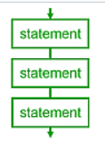
Sequence
ordered statements or subroutines executed in sequence.

Slide 7
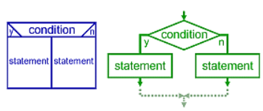
Selection
one or a number of statements is executed depending on the state of the program.
if、then、else、end if

Slide 8
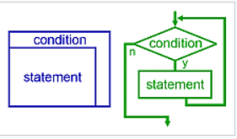
Iteration
a statement or block is executed until the program reaches a certain state, or operations have been applied to every element of a collection.
Eg:while 、repeat、for、do…until

Slide 9
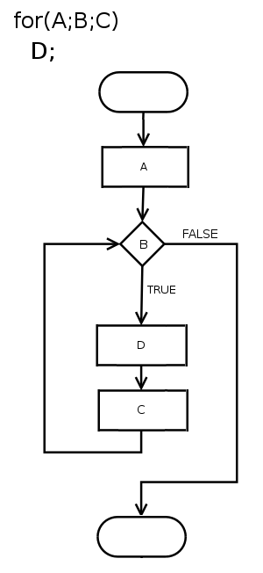
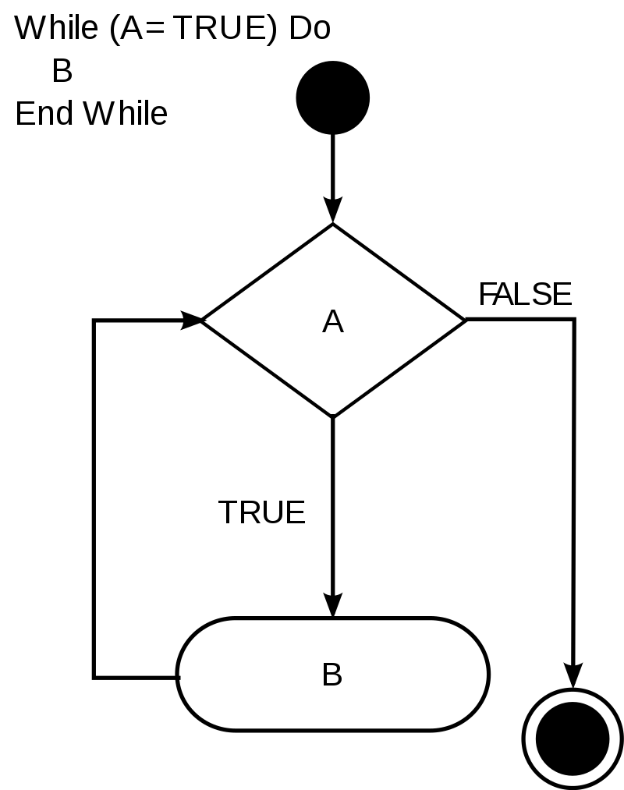

Slide 10
Recursion
A statement is executed by repeatedly calling itself until termination conditions are met.
While similar in practice to iterative loops, recursive loops may be more computationally efficient and are implemented differently as a cascading stack.

Slide 11
Why we use Structured Programming?
Let’s begin with “Goto”.

Slide 12
goto 本身的作用
“传送”
无条件转移

Slide 13
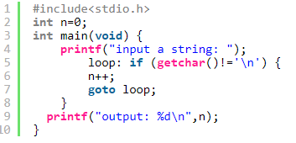
Goto本身的使用

Slide 14
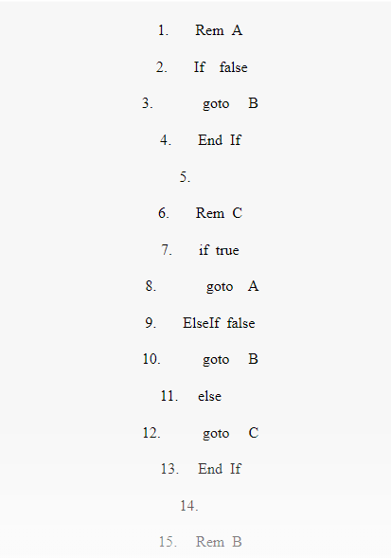
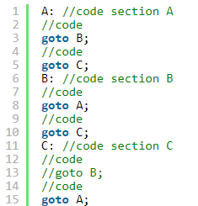
面条代码---goto的滥用

Slide 15
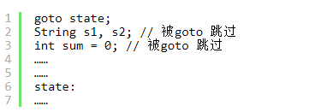
还可能存在的隐患..

Slide 17
思考：限制使用甚至不使用goto是否可行？

Slide 18
Structured program theorem
The structured program theorem, also called the Böhm–Jacopini theorem, is a result in programming language theory. It states that a class of control-flow graphs (historically called flowcharts in this context) can compute any computable function if it combines subprograms in only three specific ways (control structures). These are
Executing one subprogram, and then another subprogram (sequence)
Executing one of two subprograms according to the value of a boolean expression (selection)
Repeatedly executing a subprogram as long as a boolean expression is true (iteration)

Slide 19
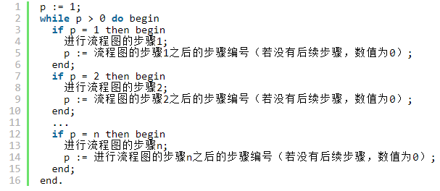
单一while循环的大众定理版本

Slide 20
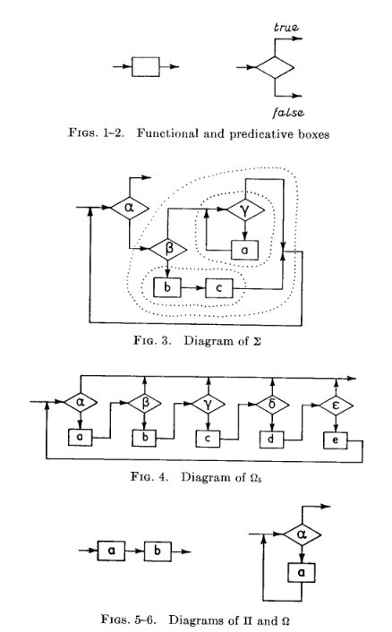
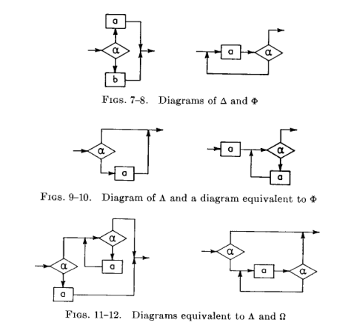
Böhm and Jacopini's proof

Slide 21
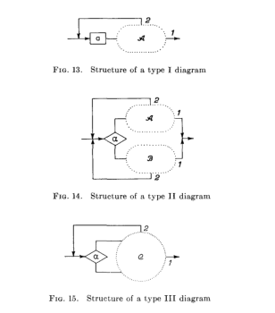
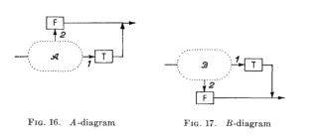

Slide 22
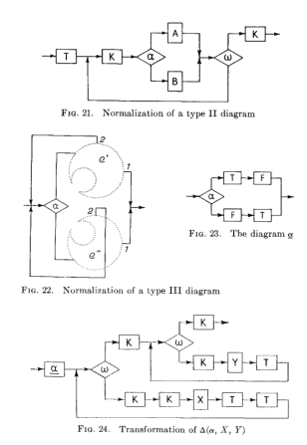
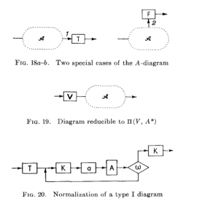

Slide 23
http://www.cs.unibo.it/~martini/PP/bohm-jac.pdf

Slide 24
The theorem forms the basis of structured programming, a programming paradigm which eschews goto commands and exclusively uses subroutines, sequences, selection and iteration.
!!!!!

Slide 25
But?
What is reasonable is real; that which is real is reasonable.
--------Hegel

Slide 26
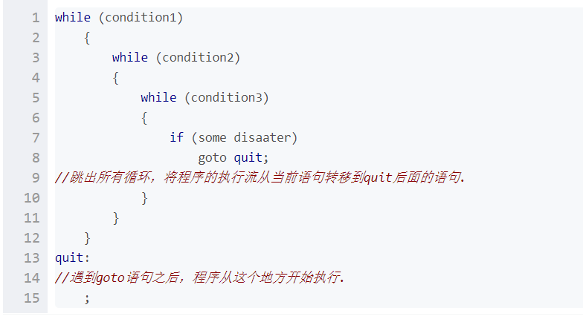
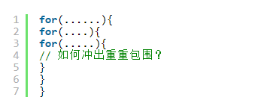
Consider about these…

Slide 27
There is an argument
支持goto方的观点：
goto 语句使用起来比较灵活，而且有些情形能提高程序的效率。
若完全删去 goto 语句，有些情形反而会使程序过于复杂，增加一些不必要的计算量…
反对goto方的观点：
goto 语句使程序的静态结构和动态结构不一致，从而使程序难以理解，难以查错。
去掉 goto 语句后，可直接从程序结构上反映程序运行的过程…

Slide 28
End of argument
1974年，高德纳对于 goto 语句争论作了全面公正的评述:
其基本观点是：不加限制地使用 goto 语句，特别是使用往回跳的 goto 语句，会使程序结构难于理解，在这种情形，应尽量避免使用 goto 语句。但在另外一些情况下，为了提高程序的效率，同时又不至于破坏程序的良好结构，有控制地使用一些 goto 语句也是必要的。

Slide 29
在有些情形，我主张删掉 goto 语句；在另外一些情形，则主张引进 goto 语句。
------------高德纳

Slide 30
THANKS！
参考资料：
1、https://en.wikipedia.org/wiki/Structured_programming
2、https://en.wikipedia.org/wiki/Structured_program_theorem
3、https://homepages.cwi.nl/~storm/teaching/reader/Dijkstra68.pdf
4、https://baike.baidu.com/item/goto%E8%AF%AD%E5%8F%A5
5、 https://baike.baidu.com/item/%E7%BB%93%E6%9E%84%E5%8C%96%E7%A8%8B%E5%BA%8F%E7%90%86%E8%AE%BA

