Slide 1
作业1-10
函数

Slide 2
We only have to show$f$is injective (one-to-one)
$f is onto⇒∀a∈ℝ,∃b∈ℝ\left(f\left(b\right)=a\right)$
As $f∘f∘f=f⇒\left(f∘f\right)∘f=f$
$$⇒\left(f∘f\right)∘f\left(b\right)=f\left(b\right) \\ ⇒\left(f∘f\right)\left(a\right)=a$$
So, it is easy to prove $f∘f=g$ is bijective, where $g(x)=x$ So, $f∘f$ is injective So, $f$ is injective
Q.E.D

Slide 3
We only have to show$f$is injective (one-to-one)
$f is onto⇒∀a∈ℝ,\left(f∘f\right)\left(a\right)=a$
Assume $∀x,y∈ℝ, x≠y,$
$x=\left(f∘f\right)\left(x\right)≠\left(f∘f\right)\left(y\right)=y$
$x=\left(f∘f\right)∘\left(f∘f\right)(x)≠\left(f∘f\right)∘\left(f∘f\right)\left(y\right)=y$
$\left(f∘\left(f∘f∘f\right)\right)\left(x\right)≠$ $\left(f∘\left(f∘f∘f\right)\right)\left(y\right)$
$\left(f∘f∘f\right)\left(x\right)≠\left(f∘f∘f\right)\left(y\right)$
$f\left(x\right)≠f\left(y\right)$
Q.E.D

Slide 4
(a) No
$X=Y=\left\{1,2\right\}, f\left(x\right)=1;A_{1}=\left\{1\right\},A_{2}\left\{1,2\right\}$
(b) assume $∃A_{1},A_{2}⊆X, f\left(A_{1}\right)=f\left(A_{2}\right),$ but $A_{1}≠A_{2}$
without loss of generality, assume $a∈A_{1}−A_{2}$
$f\left(a\right)∈f\left(A_{1}\right)=f\left(A_{2}\right)$
$∃b∈A_{2}, s.t., f\left(b\right)=f\left(a\right)$
As $f$ is injective, so $a=b$.
Therefore, $a∈A_{2}$. Contradiction.
Q.E.D.

Slide 5
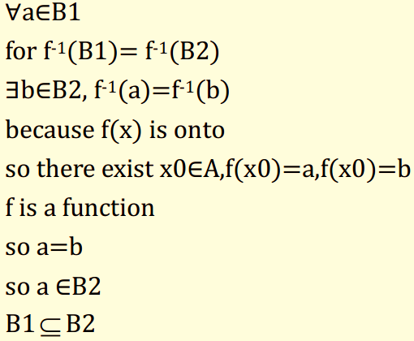
(a) $X=\left\{1,2\right\},Y=\left\{1,2,3\right\}, f\left(x\right)=1, B_{1}=\left\{1,2\right\},B_{2}=\left\{1,3\right\}$
(b)
?
$∵f is onto$
$∵∀b∈B_{1},∃a∈A,$ s.t.,$f\left(a\right)=b$
$∴a∈f^{−1}\left(B_{1}\right)=f^{−1}(B_{2})$
又$∵f is a$ function
$∴f\left(a\right)=b∈f\left(f^{−1}\left(B_{2}\right)\right)⊆B_{2}$
$∴B_{1}⊆B_{2}$
同理可证：$B_{2}⊆B_{1}$
$∴$ $B_{1}=B_{2}$
Q.E.D

Slide 6
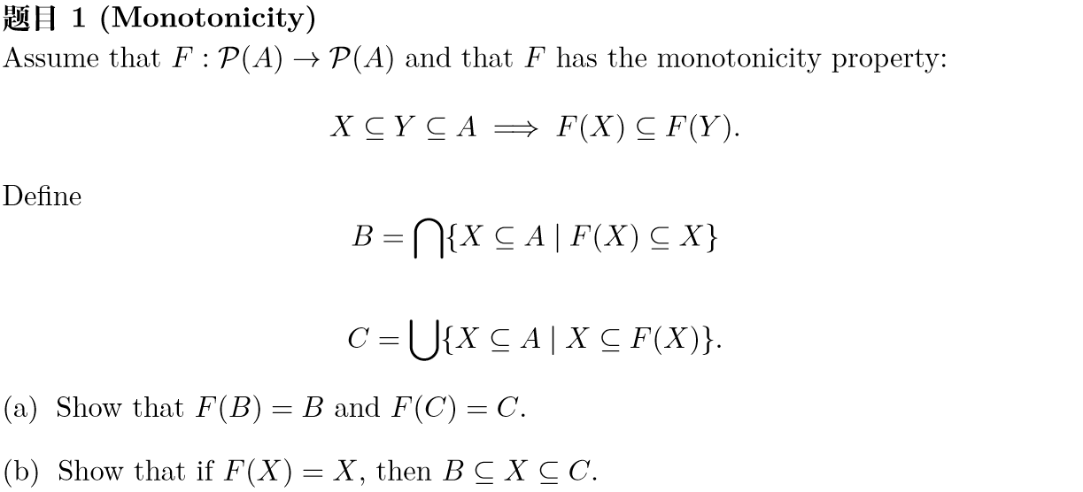
$$F\left(B\right)=B$$
(a-1) prove $F\left(B\right)⊆B$
Let $Q=\left\{X⊆A|F\left(X\right)⊆X\right\}$, then $B=⋂Q$
$∀X∈Q,B⊆X⇒F\left(B\right)⊆F\left(X\right)$
So$F\left(B\right)⊆⋂\left\{F\left(X\right)|X∈Q\right\}⊆⋂\left\{X|X∈Q\right\}=⋂Q=B$
(a-2) prove $F\left(B\right)⊇ B$
$F\left(B\right)⊆B⇒F\left(F\left(B\right)\right)⊆F\left(B\right)$
So $F\left(B\right)∈Q$
So $B⊆F\left(B\right)$
Q.E.D

