Slide 1
Decision Tree
—— Wu YuQing

Slide 2
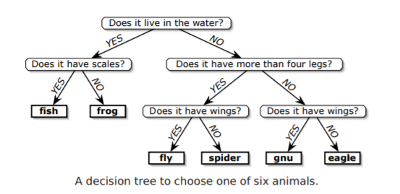
Definition
A decision tree is ？
A tree
Internal node —— query
Leaf —— a label of output

Slide 3
The lower bound of a problem
N different answers
At least N different leaves
the depth of the decision tree
logk N
the complexity of the problem
Ω(log N)

Slide 4
Information Theory
The answers to the queries must give you enough information to specify any possible outputs.
If a problem has N different outputs, then obviously any decision tree must have at least N leaves.
If every query has at most k possible answers, then the depth of the decision tree must be at least
$log$k N = Ω($log$N).

Slide 5
Problem Solving
Dictionary Problem
Let A be an array with n numbers. （sorted）
Suppose we want to determine, given a number x, the position of x in the array A, if any.

Slide 6
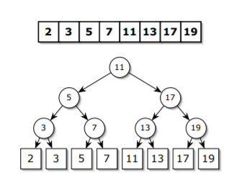
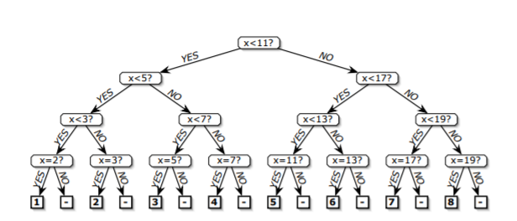
Binary Search & Decision Tree
Sort A
Use Binary Search
Be used directly as a Decision Tree

Slide 7
Sorting Problem
n! possible permutations π
At least n! leaves
depth Ω(log(n!))
This gives us the lower bound

Slide 8
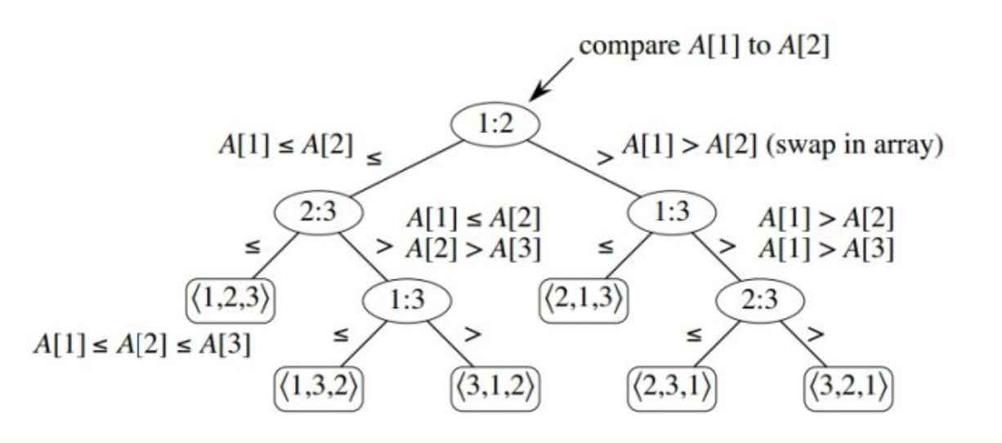
Example

Slide 9
K-ary decision tree
The examples describe binary decision trees
‘Is x greater than, equal to, or less than y?’
A k-ary decision tree is one where every query has (at most) k different answers

Slide 10
nuts-and-bolts problem
We are given n bolts and n nuts of different sizes, where each bolt exactly matches one nut.
Our goal is to find the matching nut for each bolt.
The nuts and bolts are too similar to compare directly; however, we can test whether any nut is too big, too small, or the same size as any bolt.

Slide 11
nuts-and-bolts problem
3-ary decision tree
All the possible outputs : n!
Suppose there are L leaves
L<=3^{h}

Slide 12
nuts-and-bolts problem
in the worst case, Ω(n log n) nut-bolt tests are required to correctly match up the nuts and bolts.
in the worst case, Ω(n log n) nut-bolt tests are required even to find n/2 arbitrary matching nut-bolt pairs
Notes:
状态空间(n/2)! , Ω(n/2 log n/2) = Ω(n log n)

Slide 13
K-sorted Problem
We say that an array A[1 .. n] is k-sorted if it can be divided into k blocks, each of size n/k, such that the elements in each block are larger than the elements in earlier blocks, and smaller than elements in later blocks.
The elements within each block need not be sorted.

Slide 14
The lower bound of K-sorted Problem
Make a decision tree model
Suppose the height of decision tree is h
All the possible output
Suppose there are L leaves

Slide 15
The lower bound of K-sorted Problem
requires Ω(n log k) comparisons in the worst case
K-sorted Problem has a lower bound Ω(nlog k)

Slide 16
An algorithm for K-sorted Problem
BFPTR algorithm
Find the median in linear time
Use the median as a pivot

Slide 17
K-sorted Problem
sort a k-sorted array
All the possible output
requires Ω(n log(n/k)) comparisons in the worst case
Notes:
在考虑总的状态空间时，我们可以先考虑将两个长度为k的有序列归并成1个有序列时有多少种归并法。
我们先将其中一个有序列固定，把另一个有序列不考虑暂时不考虑其元素之间的偏序关系，用夹板法插入第一个有序列中，共有（k+1）*（k+2）*……（2k）种。
此时再考虑第二个有序列元素之间的偏序关系，则总状态空间除以 k！为C(2n,n)
吐血了，我怎么这么蠢，在2n个位置中选出n个排a,选出n个排b，直接列式得出C（2n，n）
以此做归纳，总的状态空间数为: [(k+1)*(k+2)*…..*(2k)/k!]*[(2k+1)*(2k+2)*…..*(3k)/k!]*…….*[(n-k+1)*(n-k+2)*…..*(n)/k!]=n!/[(k!)^(n/k)] 。
因此总的叶子个数L>= n!/[(k!)^(n/k)] .
因此h>=Ω（L） = Ω(n log(n/k))

Slide 18
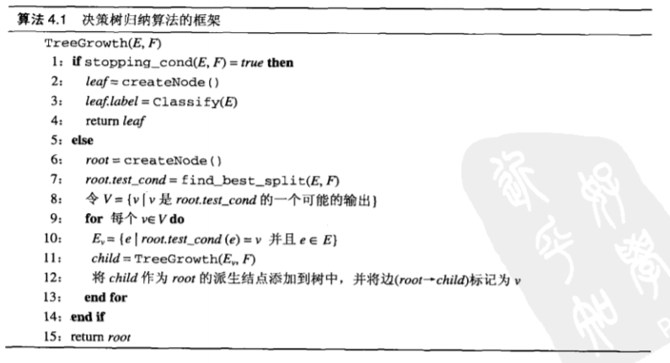
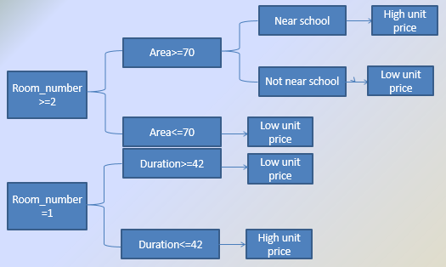
Application in data mining
Supervised learning (with labels)
ID3 C4.5
《 Introduction to Data Mining》

Slide 19
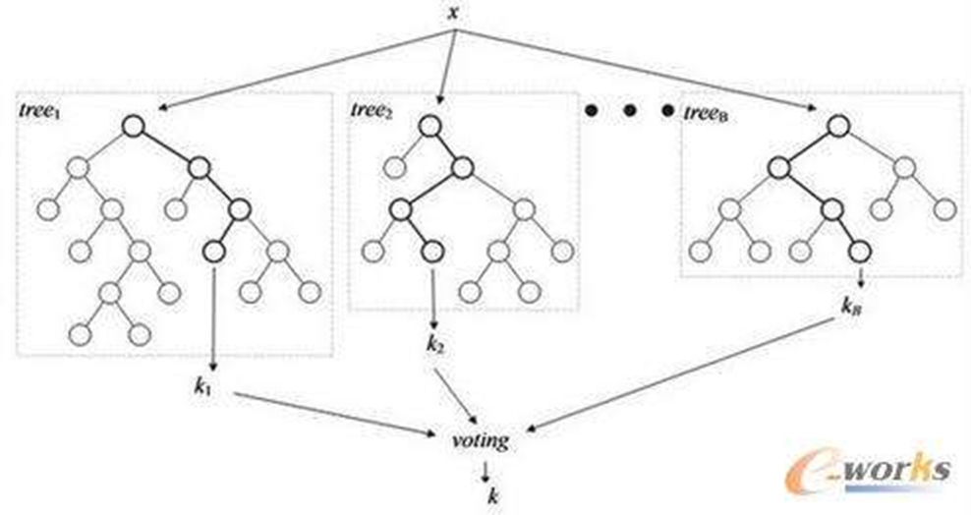
Application in data mining
Import numpy
Random Forest

Slide 20
Reference ( ranked by contribution )
Lecture-note by jeffe
Hengxin Wei
Data mining : An Introduction
CSDN
Mr Yan

