Slide 1
Chu-Liu/Edmonds’ algorithm OT 3-6
吴煜青

Slide 2
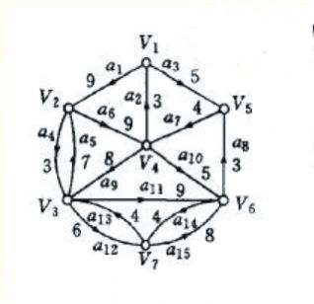
Problem
One day , Mr ant met a problem . . . .
He found that the Prim algorithm he learnt didn’t work
Finding a spanning arborescence of minimum weight

Slide 3
Definition (from Edmonds)
A forest is a graph which contains no polygon.
A branch is a forest whose edges are directed so that each is directed toward a different node.
An arborescence is a connected branching.

Slide 4
Chu-Liu/Edmonds’ algorithm
The algorithm was proposed independently first by Yoeng-Jin Chu and Tseng-Hong Liu (1965) and then by Jack Edmonds (1967).
Chu, Y. J.; Liu, T. H. (1965), "On the Shortest Arborescence of a Directed Graph", Science Sinica, 14: 1396–1400
Edmonds, J. (1967), "Optimum Branchings", J. Res. Nat. Bur. Standards, 71B: 233–240, doi:10.6028/jres.071b.032
Tarjan, R. E. (1977), "Finding Optimum Branchings", Networks, 7: 25–35, doi:10.1002/net.3230070103

Slide 5
Description
Takes as input a directed graph D = <V,E>
V is the set of nodes
E is the set of directed edges
A distinguished vertex called the root
A real-valued weight w(e) for each edge
Return a spanning arborescence A rooted at r of minimum weight

Slide 6
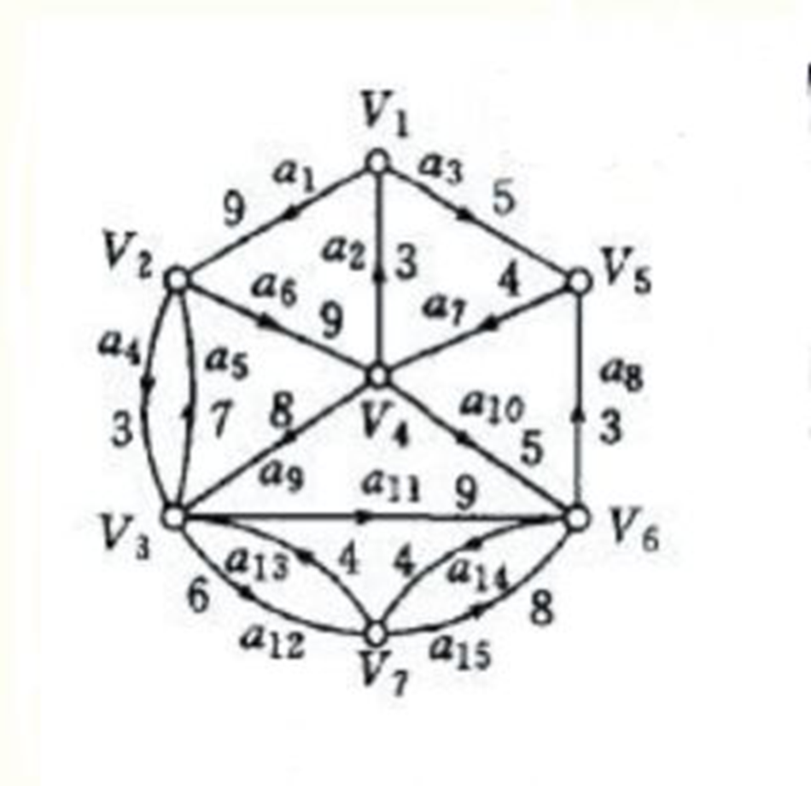
Description
Let f(D , r , w) denote the function which returns a spanning arborescence rooted at r of minimum weight.
First remove any edge from E whose destination is r.
Replace any set of parallel edges by a single edge with weight equal to the minimum of the weights of these parallel edges.

Slide 7
Description
For each node v other than the root, find the edge incoming to v of lowest weight.
Denote the source of this edge by
If the set of edges does not contain any cycles, then f (D , r , w) = P.

Slide 8
Description

Slide 9
Description
Otherwise, P contains at least one cycle.
Arbitrarily choose one cycle and call it C.
Define a new weighted directed graph D’ = <V’ , E’> in which the cycle C is “contracted” into one node as follows:
(The nodes of V’ are the nodes of V not in C plus a new node denoted )

Slide 10
Description
If is an edge in E with and (an edge coming into the cycle) , then include in E’ a new edge , and define .
If is an edge in E with and (an edge going away from the cycle), then include in E’ a new edge
and define .

Slide 11
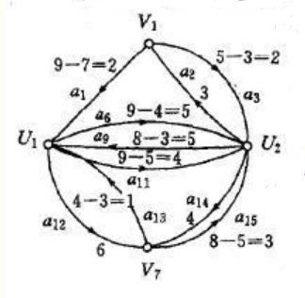
Description
If is an edge in E with and (an edge unrelated to the cycle), then include in E’ a new edge , and define .
For each edge in E’, we remember which edge in E it corresponds to.

Slide 12
Description

Slide 13
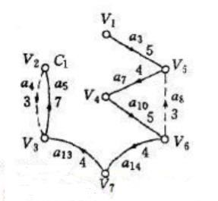
Description
Now find a minimum spanning arborescence A’ of D’ using a call to .
Since A’ is a spanning arborescence, each vertex has exactly one incoming edge.
Let be the unique incoming edge to in A’. This edge corresponds to an edge with .

Slide 14
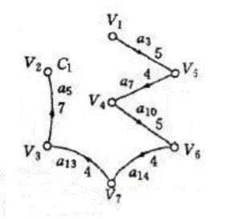
Description
Remove the edge from C, breaking the cycle.
Mark each remaining edge in C. For each edge in A’ , mark its corresponding edge in E. Now we define f(D , r , w) to be the set of marked edges, which form a minimum spanning arborescence.

Slide 16
Correctness
D’ has strictly fewer vertices than D.
Find f( D , r , w ) for a single-vertex graph is trivial (it is just D itself), so the recursive algorithm is guaranteed to terminate.
Edmonds’ correctness proof uses concepts of linear programming

Slide 17
legal inputs
Every vertex of E is reachable from r
To simplify matters we shall assume that E is strongly connected.(If not, we add dummy edges of suitably large cost from each vertex to r)

Slide 18
Running time
The running time of this algorithm is O(EV)
A faster implementation of the algorithm due to Robert Tarjan runs in time for sparse graphs and for dense graphs. This is as fast as Prim algorithm for an undirected minimum spanning tree.

Slide 19
Refence
Wikipedia
洛谷P4716
Mr Ma

