Slide 1
作业1-4

Slide 2
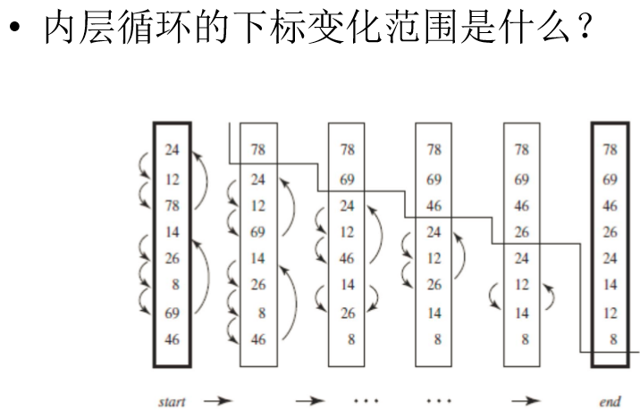
2.2. Consider the bubblesort algorithm presented in the text. (a) Explain why the outer loop is performed only N − 1 times. (b) Improve the algorithm so that on every repeated execution of the outer loop, the inner loop checks one element less.
(a)每次确定一个数位置，当N-1个数的位置确定，第N个必然也确定了。
(b)
i=0;
i=i+1;
N-i

Slide 3
2.5 Show how to perform the following simulations of some control constructs by others. The sequencing construct “and-then” is implicitly available for all the simulations. You may introduce and use new variables and labels if necessary.
Simulate a “for-do” loop by a “while-do” loop.
Simulate the “if-then” and “if-then-else” statements by “while-do” loops.
if A then B
=>
while A do {B; break;}
if A then B else C
=>
while A do {B; break;}
while !A do {C; break;}
for (A;B;C) do D
=> A; while(B) do {D;C;}
?

Slide 4
2.5 Show how to perform the following simulations of some control constructs by others. The sequencing construct “and-then” is implicitly available for all the simulations. You may introduce and use new variables and labels if necessary.
Simulate a “for-do” loop by a “while-do” loop.
for (A;B;C) do D => A; while(B) do {D;C;}
Simulate the “if-then” and “if-then-else” statements by “while-do” loops.
if A then B =>
t=true;
while (A&&t) do {B; t=false;}
if A then B else C=>
t1=true;t2=true;
while (A&&t1) do {B; t1=false;}
while (t1&&t2) do {C; t2=false;}

Slide 5
2.5 Show how to perform the following simulations of some control constructs by others. The sequencing construct “and-then” is implicitly available for all the simulations. You may introduce and use new variables and labels if necessary.
Simulate a “while-do” loop by “if-then” and “goto” statements.
Simulate a “while-do” loop by a “repeat-until” loop and “if-then” statements.
F:if A then begin
B;
goto F;
end
while A do B
=>
while A do B
=>
if A then repeat B until !A

Slide 6


2.7. Write algorithms that compute N!, given a non-negative integer N. (a) Using iteration statements. (b) Using recursion.
Factorial(n)
res $←$1
for i:=1~n do
res $←$ res$×$I
return res
Factorial(n)
if n=0 or n=1
return 1
return n$×$Factorial(n-1)

Slide 7
2.8 Show how to simulate a “while-do” loop by conditional statements and a recursive procedure.
F(){
if A then{
B;
F();
}
}
while A do B;

Slide 8
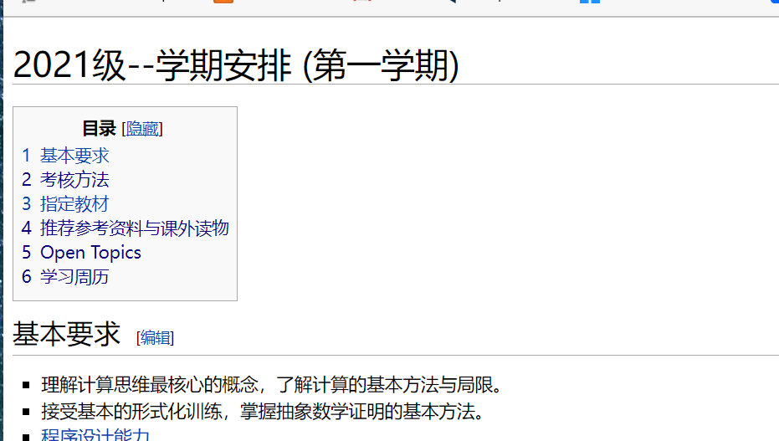
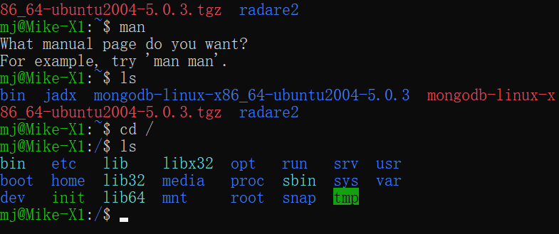
有Bound，但Bound不可预知
例：输入规模没有预先告知
无Bound（应用自身需求）
例：web服务器， shell命令执行

