Slide 1
Open Topics Something about SAT Problem
171860538 陶绍诚
2019.5.12

Slide 2
Contents
1. Introduction to SAT and Max-SAT problem.
2. Why SAT is so hard?
3. Some algorithms to solve SAT.

Slide 3
What is CNF?
1
In Boolean logic, a formula is in conjunctive normal form (CNF) or clausal normal form if it is a conjunction of one or more clauses, where a clause is a disjunction of literals; otherwise put, it is an AND of ORs. As a canonical normal form, it is useful in automated theorem proving and circuit theory.
Examples

Slide 4
Satisfiability Problem (SAT)
1
A decision problem

Slide 5
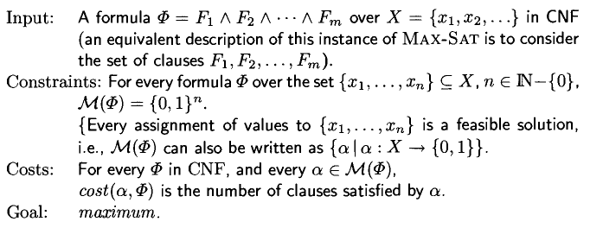
Maximum Satisfiability Problem (Max-SAT)
1
An optimization problem

Slide 6
Why we focus on SAT?
Theoretical importance
- SAT is the first NPC problem(Cook-Levin Theorem, 1971)
Many practical applications
- Model Checking
- Planning in AI
- Software Verification
- Automatic Test Pattern Generation
(Logic is the mother of subjects)

Slide 7
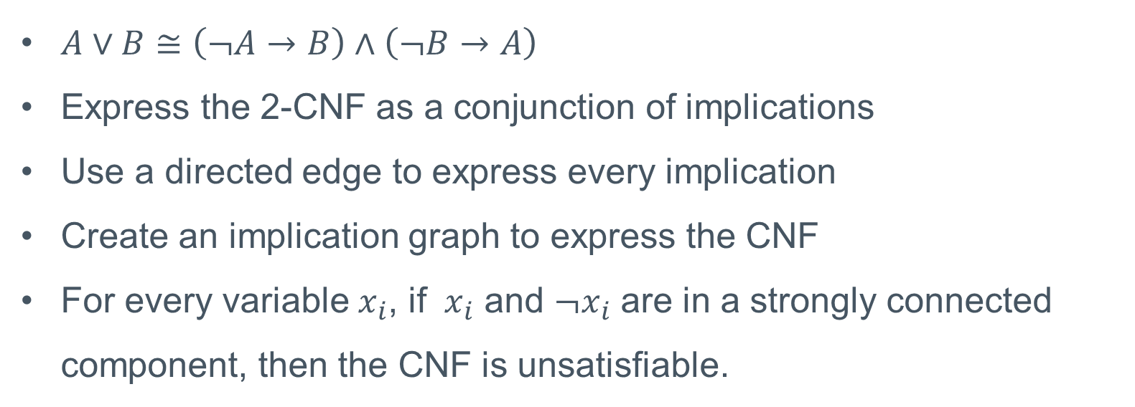
Why so hard?
2
2-SAT can be solved in polynomial time(linear indeed)
Algorithm skeleton
$A∨B≅\left(¬A→B\right)∧\left(¬B→A\right)$
Express the 2-CNF as a conjunction of implications
Use a directed edge to express every implication
Create an implication graph to express the CNF
For every variable $x_{i}$, if ${ x}_{i}$ and ${¬x}_{i}$ are in a strongly connected component, then the CNF is unsatisfiable.

Slide 8
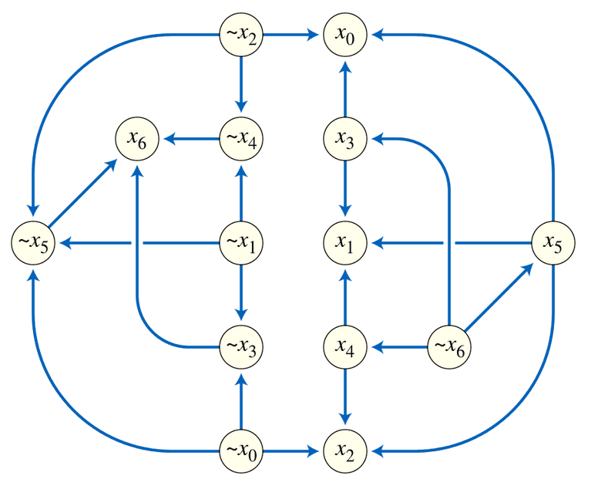
Example
2
From wikipedia

Slide 9
2
Applied to 3-SAT?
$A∨B∨C≅\left(¬A→B∨C\right)∧…≅\left(¬A→((¬B→C\right)∧$ $(¬C→B)))∧…$
Hard to draw an implication graph because of complicated implicating relation
K-SAT is NP when k>2

Slide 10
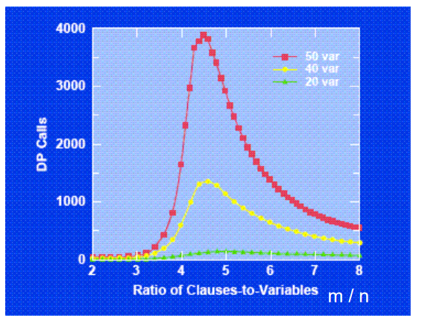
Hardness transitions in k-SAT
2
For fixed k, let SAT problem comprise m clauses and n variables
3-SAT Problem
Hardness transition grows sharper as n increases
From berkeley.edu

Slide 11
Some Algorithms to solve SAT
3
Davis-Putnam algorithm(DP)
- Based on resolution
Davis–Putnam–Logemann–Loveland (DPLL) algorithm
- Based on search and backtracking
- Basis for current most successful solvers
Stalmarck’s algorithm
- More of a “breadth first” search, proprietary algorithm
Stochastic search
- Local search, hill climbing, etc.– Unable to prove unsatisfiability (incomplete)

Slide 12
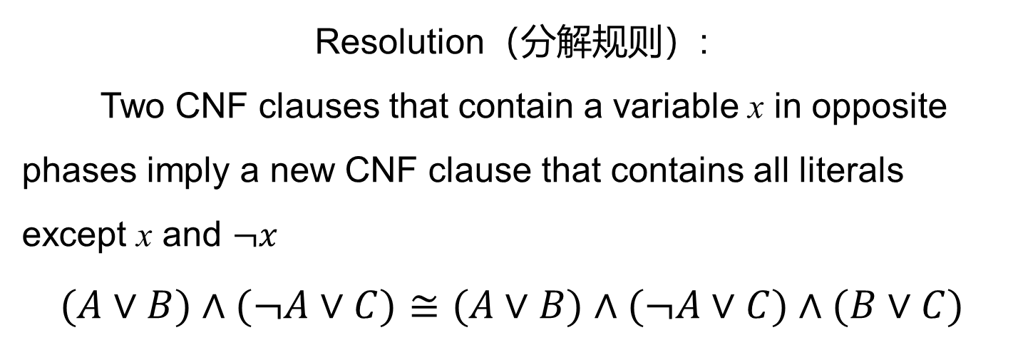
Davis-Putnam algorithm
3
Resolution（分解规则）:
Two CNF clauses that contain a variable x in opposite phases imply a new CNF clause that contains all literals except x and $¬x$
$$(A∨B)∧(¬A∨C)≅(A∨B)∧(¬A∨C)∧(B∨C)$$

Slide 13
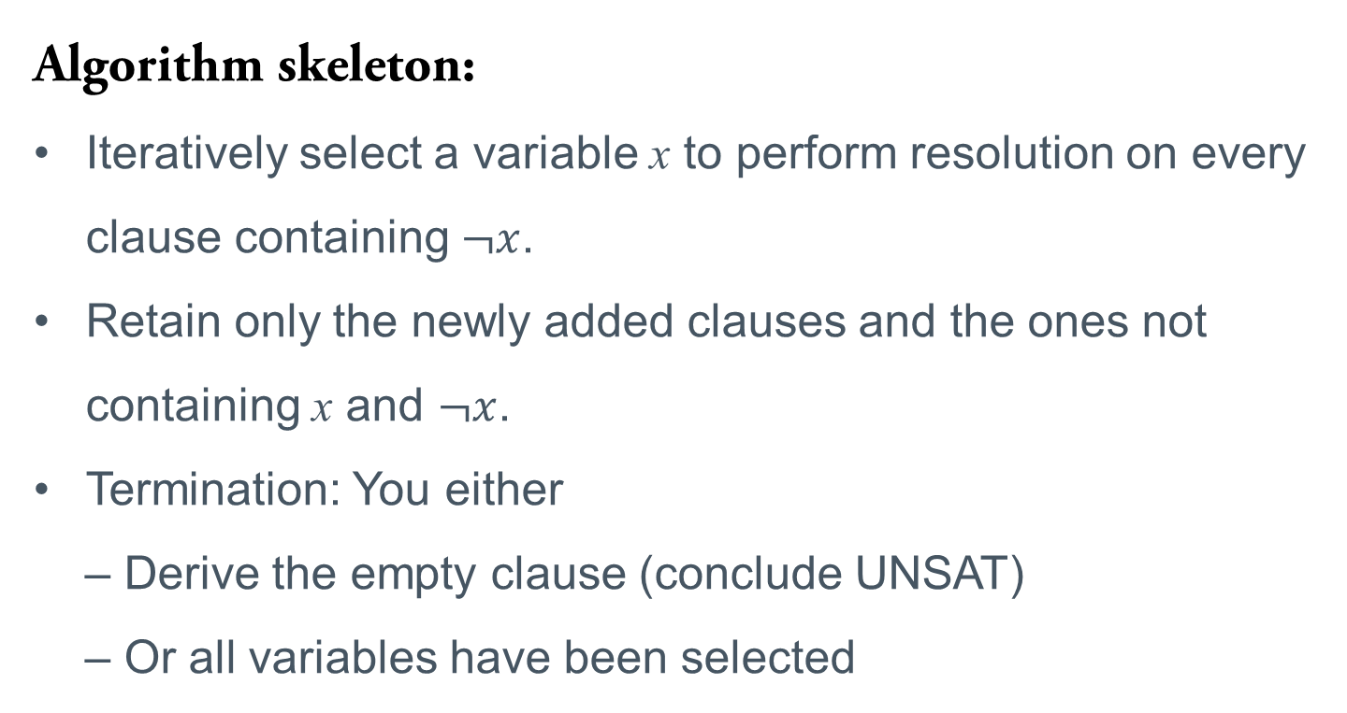
Davis-Putnam algorithm
3
Algorithm skeleton:
Iteratively select a variable x to perform resolution on every clause containing $¬x$.
Retain only the newly added clauses and the ones not containing x and $¬x$.
Termination: You either
– Derive the empty clause (conclude UNSAT)
– Or all variables have been selected

Slide 14
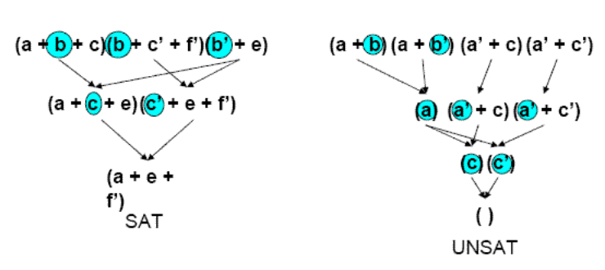
Resolution example
3

Slide 15
DPLL algorithm
3
General Ideas:
Iteratively set variables until
– You find a satisfying assignment (done!)
– You reach a conflict (backtrack and try different value)
Two main rules:
– Unit Literal Rule: If an unsatisfied clause has all but 1 literal set to 0, the remaining literal must be set to 1
– Conflict Rule: If all literals in a clause have been set to 0, the formula is unsatisfiable along the current assignment path

Slide 16
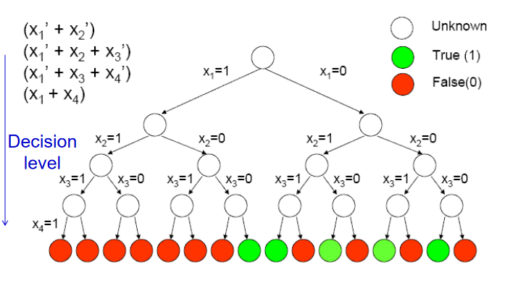
DPLL example
3
Search Tree

Slide 17
Optimization
3
Pre-processing: Pure Literal Rule.
How to set the variable?
- Greedy: to satisfy most clauses.
- Random
Where to backtrack?
- Chronological: backtrack to highest decision level that has not been tried with both values(original DPLL paper).
- Non-chronological: Decision Heuristic Desiderata, Sample Decision Heuristics, VSADS…

Slide 18
References:
https://www.geeksforgeeks.org/2-satisfiability-2-sat-problem/
https://rjlipton.wordpress.com/2009/07/13/sat-solvers-is-sat-hard-or-easy/
https://ptolemy.berkeley.edu/projects/embedded/eecsx44/fall2011/lectures/SATSolving.pdf
https://www.wikipedia.org

Slide 19
Thanks

