Slide 1
作业1-8
集合及其运算

Slide 2
$$\bigcup_{α∈I}{𝒫\left(A_{α}\right)=}B,∀x\left(x∈B⇔∃α∈I\left(x∈𝒫\left(A_{α}\right)\right)\right)$$
$$x∈B⇔∃α∈I\left(x⊆A_{α}\right) \\ ⇒x⊆\bigcup_{α∈I}{A_{α}} \\ ⇒x∈𝒫\left(\bigcup_{α∈I}{A_{α}}\right)$$

Slide 3
$∀x∈𝒫\left(\bigcap_{α∈I}{A_{α}}\right)$ $⇔x∈𝒫\left(\bigcap_{α∈I}{A_{α}}\right)$ $⇔x⊆\bigcap_{α∈I}{A_{α}}$ $⇔∀y \left(y∈x⇒y∈\bigcap_{α∈I}{A_{α}}\right)$ $⇔∀y\left(y∈x⇒∀α∈I\left(y∈A_{α}\right)\right)$
$⇔∀α∈I\left( ∀y\left(y∈x⇒y∈A_{α}\right)\right)$ $⇔∀α∈I\left( x⊆A_{α}\right)$ $⇔∀α∈I\left( x∈𝒫\left(A_{α}\right)\right)$ $⇔ x∈\bigcap_{α∈I}{𝒫\left(A_{α}\right)}$

Slide 4
$\left(x,y\right)∈A×\left(B\backslash C\right)$
$⇔x∈A∧y∈\left(B\backslash C\right)$
$⇔x∈A∧\left(y∈B∧y∉C\right)$
$⇔ x∈A∧y∈B∧y∉C$
$$\left(\left(x,y\right)∈A×B\right)∧\left(（x,y）∉A×C\right)$$
$$⇔x∈A∧y∈B∧\left(x∉A∨y∉C\right)$$
$⇔\left(x∈A∧y∈B∧x∉A \right)∨\left(x∈A∧y∈B∧y∉C\right)$
$⇔x∈A∧y∈B∧y∉C$

Slide 6
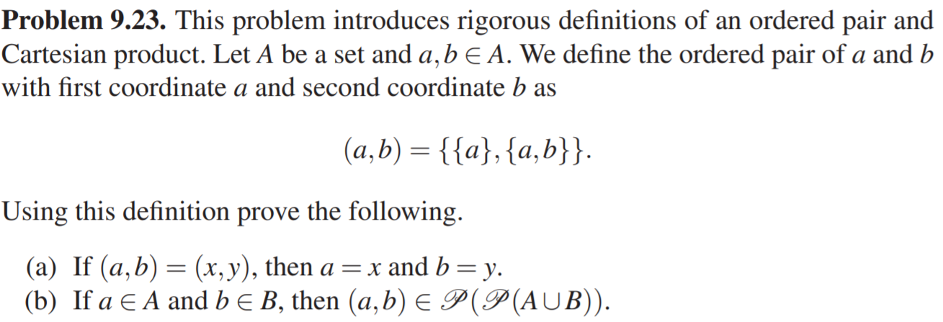
$$\left(a,b\right)=\left\{\left\{a\right\},\left\{a,b\right\}\right\}=\left\{\left\{x\right\},\left\{x,y\right\}\right\}=\left(x,y\right)$$
则必然：
$$\left(1\right): \left\{a\right\}=\left\{x\right\} \\ \left(2\right): \left\{a,b\right\}=\left\{x,y\right\}$$
假设$a≠x，$则(1)不成立，矛盾
假设$b≠y，$由(2)可得：$b=x，a=y；$
又因为$a=x$，所以$b=x=a=y$，矛盾

Slide 7
$∵a∈A,b∈B$
$∴a,b∈A⋃B$
$∴\left\{a\right\},\{a,b\}⊆A⋃B$
$∴\left\{a\right\},\{a,b\}∈𝒫\left(A⋃B\right)$
$∴\left(a,b\right)=\left\{\left\{a\right\},\left\{a,b\right\}\right\}⊆𝒫\left(A⋃B\right)$
$∴\left(a,b\right)=\left\{\left\{a\right\},\left\{a,b\right\}\right\}∈𝒫\left(𝒫\left(A⋃B\right)\right)$

Slide 8
目标：$∀x(x∈A×B⇒x∈C×D)$
Proof：
Let $x=\left(a,b\right)=\left\{\left\{a\right\},\left\{a,b\right\}\right\}∈A×B⊆𝒫\left(𝒫\left(A⋃B\right)\right), for some a∈A,b∈B$
$∵A⊆C,B⊆D$
$∴A∪B⊆C∪D$
$∴𝒫\left(A⋃B\right)⊆𝒫\left(C⋃D\right)$
$∴𝒫\left(𝒫\left(A⋃B\right)\right)⊆𝒫\left(𝒫\left(C⋃D\right)\right)$
$∴x∈𝒫\left(𝒫\left(C⋃D\right)\right)$
$∵a∈A⊆C,b∈B⊆D$
$∴x∈C×D(由定义可得)$
参考习题9.8结论：
$$A⊆B iff 𝒫\left(A\right)⊆𝒫\left(B\right)$$

Slide 9
已知：$A⊆B$
证：$𝒫\left(A\right)⊆𝒫\left(B\right)$
已知：$𝒫\left(A\right)⊆𝒫\left(B\right)$
证： $A⊆B$
$$x∈𝓟\left(A\right)⇔x⊆A \\ ⇒x⊆B \\ ⇔x∈p\left(B\right)$$
$$x∈A \\ ⇔\left\{x\right\}⊆A \\ ⇔\left\{x\right\}∈𝒫\left(A\right) \\ ⇒\left\{x\right\}∈𝒫\left(B\right) \\ ⇔\left\{x\right\}⊆B \\ ⇔x∈B$$
$$𝓟\left(A\right)⊆𝓟\left(B\right) \\ ⇔∀x\left(x∈𝒫\left(A\right)⇒x∈𝒫\left(B\right)\right) \\ ⇔∀x\left(x⊆A⇒x⊆B\right) \\ ⇒∀z\left(\left\{z\right\}⊆A⇒\left\{z\right\}⊆B\right)$$
$⇔∀z\left(z∈A⇒z∈B\right)$
$⇔A⊆B$

